Slide 1
The
Green
Industrial
Revolution
28 October 2012
Woodrow W. Clark MA3, PhD
Qualitative Economist
Academic Specialist
Cross-disciplinary Scholars in Science and Technology
Woodrow W. Clark

Slide 2
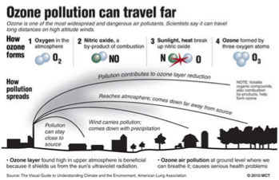
The Next Economics

Slide 3
Need of A Paradigm Change The World is Round – Not Flat

Slide 4
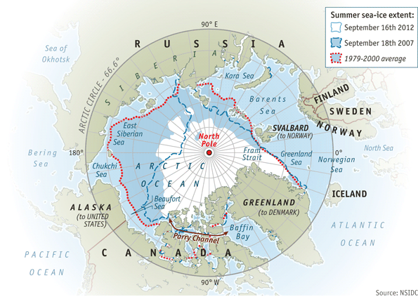
Summer Ice in the Arctic Ocean: Vanishing Rapidly (Economist, 22 Sept 2012:p.89

Slide 5
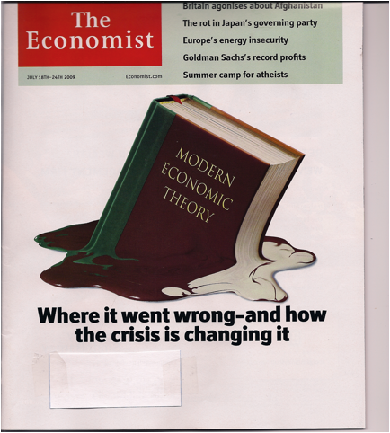
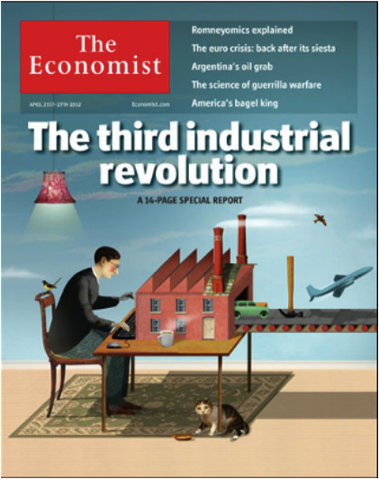
The Global Toward The Green Economic Revolution Change
5

Slide 6
Economist: Schumpeter September 15, 2012: p. 65
Global Movers and Shakers are worried about China

Slide 7
Sustainable Green Communities

Slide 8
The Green Economic Revolution
Vision: Controlling and Mitigating Climate Change
Economic Change through Innovation and Technology:
The Case of Energy
Have an Energy Environmental Plan with built in financing mechanisms
Efficient and Conservative energy use along with Renewable Energy through On-site power and Central Grid Generation forming Agile Systems
Demand Side Management Performance and Power Contracts that are long-term and economical
Green and Blue Tech for renewable energy systems such as solar, wind, ocean and wave power integrated with chemical, electronic and engineering technologies
Smart Green Grid – central systems and on-site power
National, regional, state and local plans integrated green technologies and provide financial support
Sustainable Development and Education Cross-Disciplinary Curriculum –including Science, Health, Medicine Social Studies, and Applied Fields in Infrastructures (water, waste, transportation, IT etc) with Archecuture, Design, Career Education, Training, Entrepreneurship and New Ventures.
Global alliances including IP and Finance

Slide 9
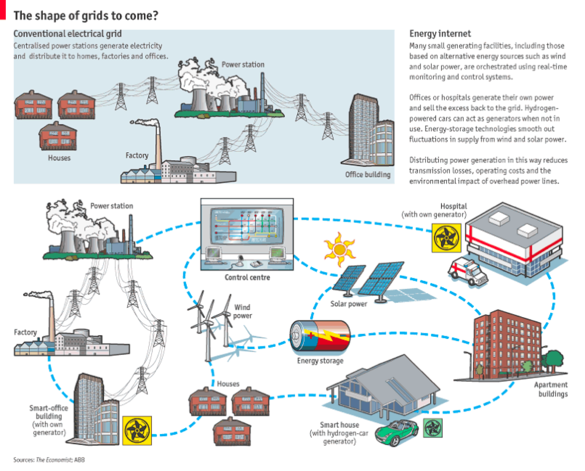
Agile Energy Communities

Slide 10
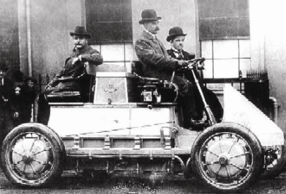
First Hybrid car Where and how America learned its lesson in delaying environmental technologies
1903 Lohner-Porsche Carriage
Notes:
10
Graph to show exponential tech/scientific improvements in recent years?
Ford (US?)
- e.g. of regenerative breaking (now on the Prius)… has been around for 100 yrs. Offered to Ford, GM, Chrystler, turned down…. Japanese took it up.

Slide 12
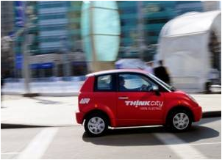
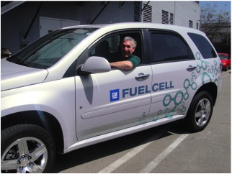
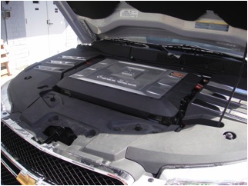
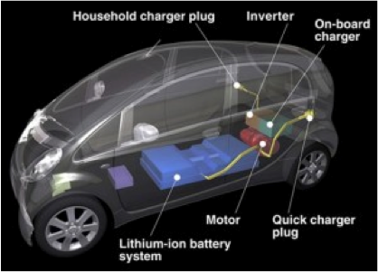
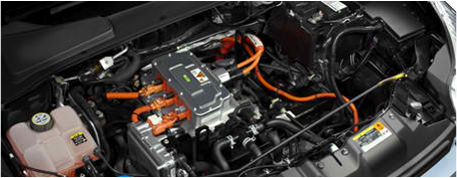
Personal Transportation: from electric to H2FC the Globe
Electric Cars (“The Think City” from Norway)
GM: Hydrogen Fuel Cells
iPad of Electric Cars: Mitsubishi i-MiEV
Electric Motors: Engineering Revolution
Notes:
- Put earlier where talk about cars?

Slide 13
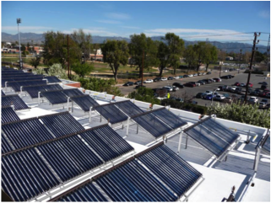
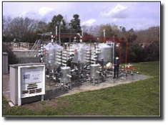
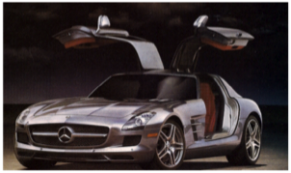
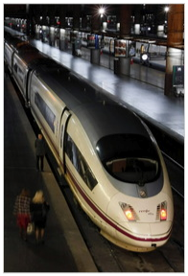
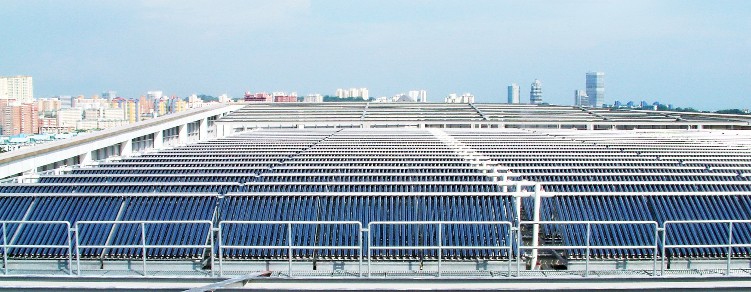
Today’s Examples of where global energy and environmental innovations are … Technologies

Slide 14
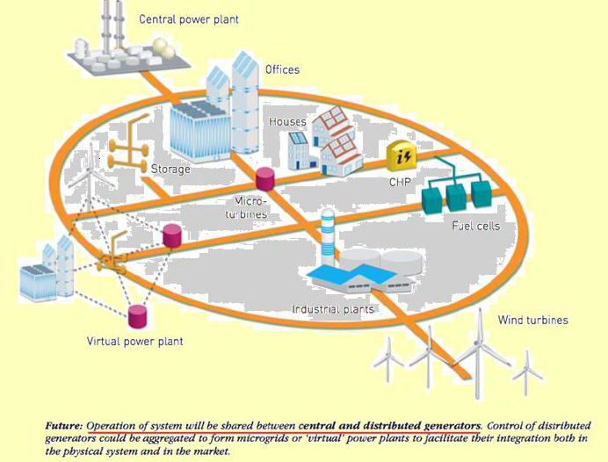
Future Grid and On-Site Power Today

Slide 15
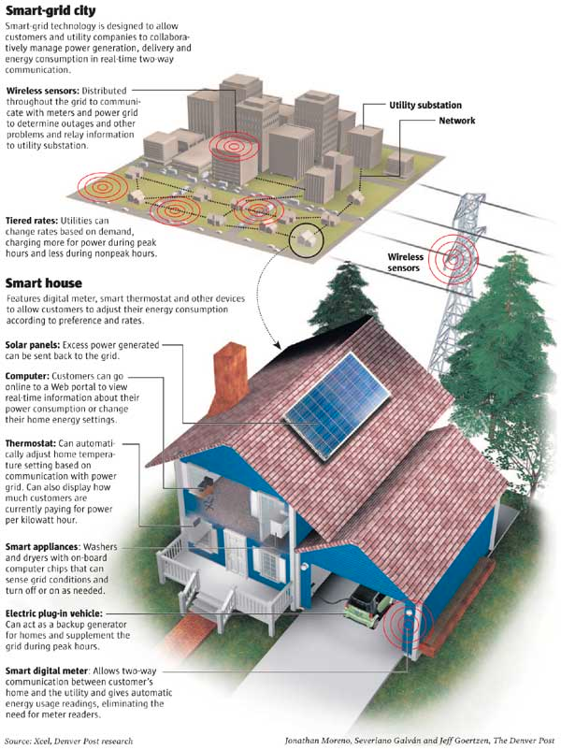
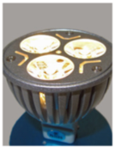

Slide 16
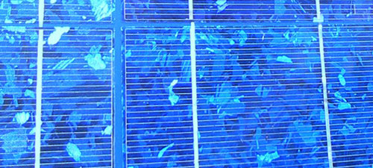
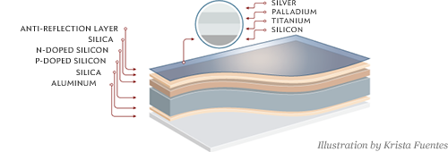
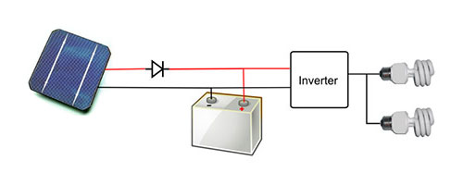
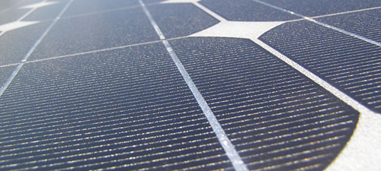
Solar System: Oberlin College

Slide 17
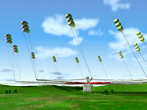
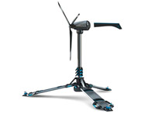
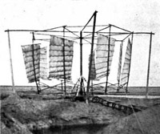
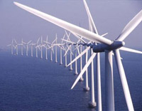
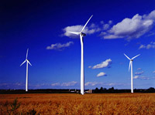
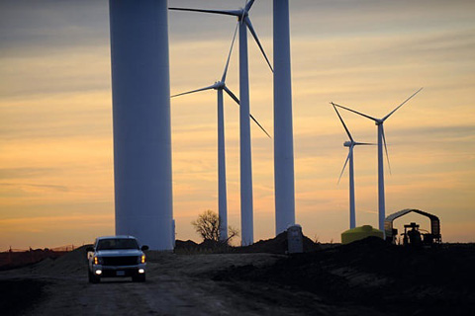
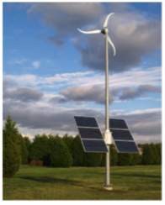
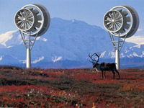
Wind Turbines

Slide 18
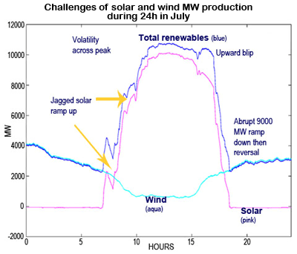
Integration of Intermittent Systems Tech Notes: DNV KEMA (11 October 2012)

Slide 19
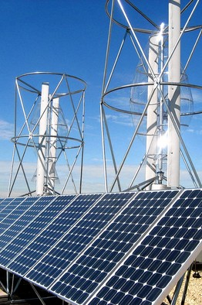
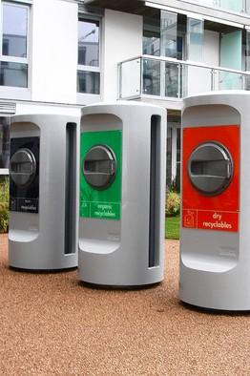
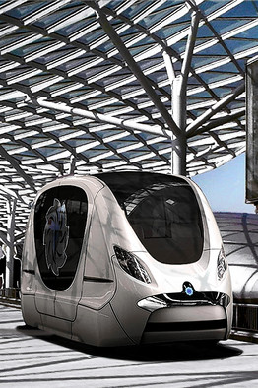
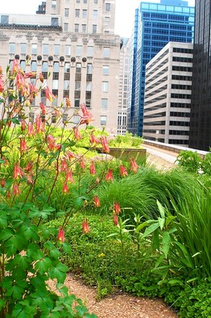
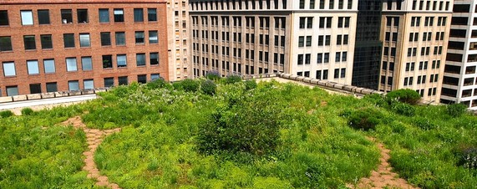
Sustainable Communities

Slide 20
Sustainable Communities: Chapter #8: Google -- Recharging Car(1.6MW) Solar Campus Goal: carbon neutral by end of 07

Slide 21
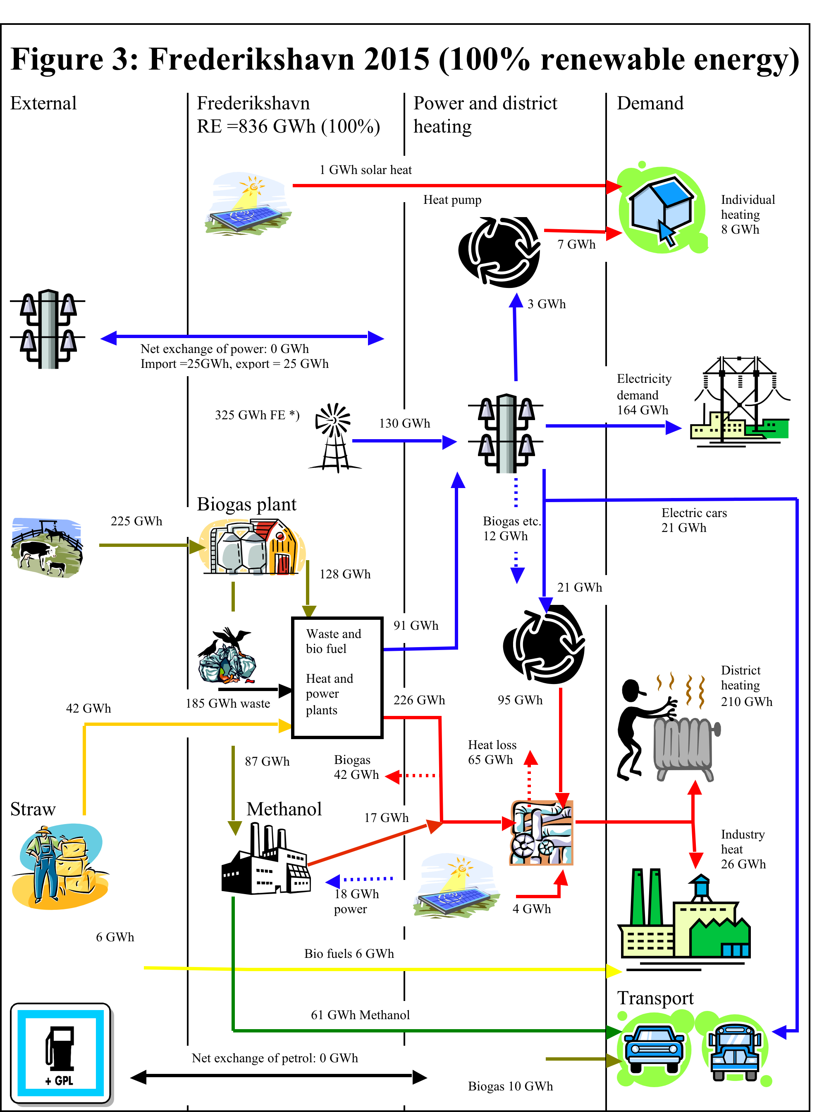
Sustainable Communities: Chapter # 10: Frederickshavn, DK Energy Independent Plan, 2015 Electricidad distribuida

Slide 22
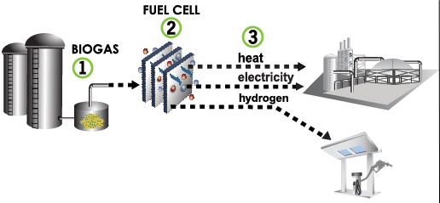
Tri-Generational

Slide 23
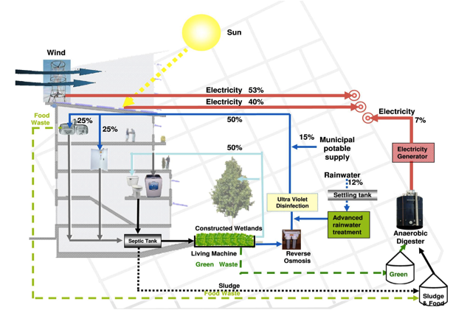
Integrated Green Smart Systems

Slide 24
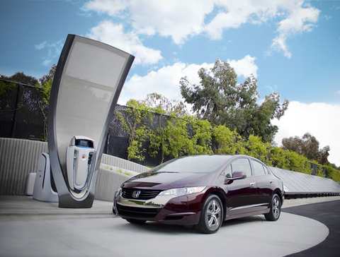
Honda Clarity: H2 Fuel Cell Car

Slide 25
Commercialization Scenario for FCVs and H2 Stations
Phase 1
Technology
Demonstration
【JHFC-2】
Phase 2
Technology & Market
Demonstration
【Post JHFC】
Phase 3
Early Commercialization
Phase 4
Full Commercialization
【Profitable business Period】
【Starting Period】
【Expansion Period】
2010 2011
2015 2016
2025 2026
Solving technical issues and promotion of review regulations (Verifying & reviewing development progress as needed)
Expanding production and sales of FCVs while maintaining convenience of FCV users
Reducing costs for H2 stations and hydrogen fuel
Continuously conducting technology development and review of regulations
Contribute to diversity of
energy sources and
reduction of CO2 emissions
H2 Station Number
Verifying utility of FCVs and H2 stations
from socio-economic
viewpoint
Year 2025
Increase numbers of FCV and H2 stations
based on profitable business
Approx. 1,000 H2 stations*
Year 2015
Target commercialization start
of FCV to general public
Costs for H2 station construction and hydrogen reach targets, making the station business viable.
(FCV 2,000 units/station)
Approx. 2 million FCVs*
Determine specifications of
commercial type H2 stations
Begin building
commercial type H2 stations
Period in which preceded H2 station building is necessary
Vehicle Number
Increase of FCV numbers through introduction of more vehicle models
Year
Note: Vertical axis indicates the relative scale between vehicle number & station number.
* Precondition: Benefit for FCV users (price/convenience etc.) are secured, and FCVs are widely and smoothly deployed

Slide 28
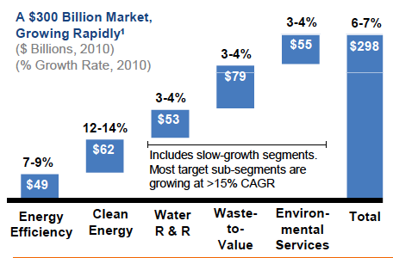
The Green Industrial Revolution The Economics, Finance and Investments

Slide 29
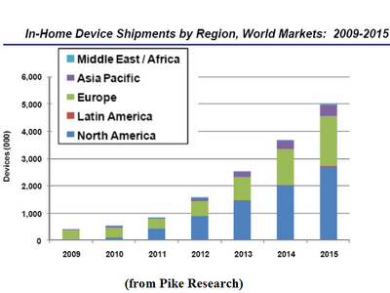
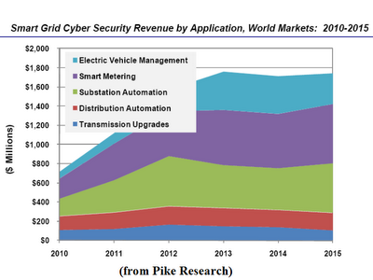
Smart Grid Markets

Slide 30
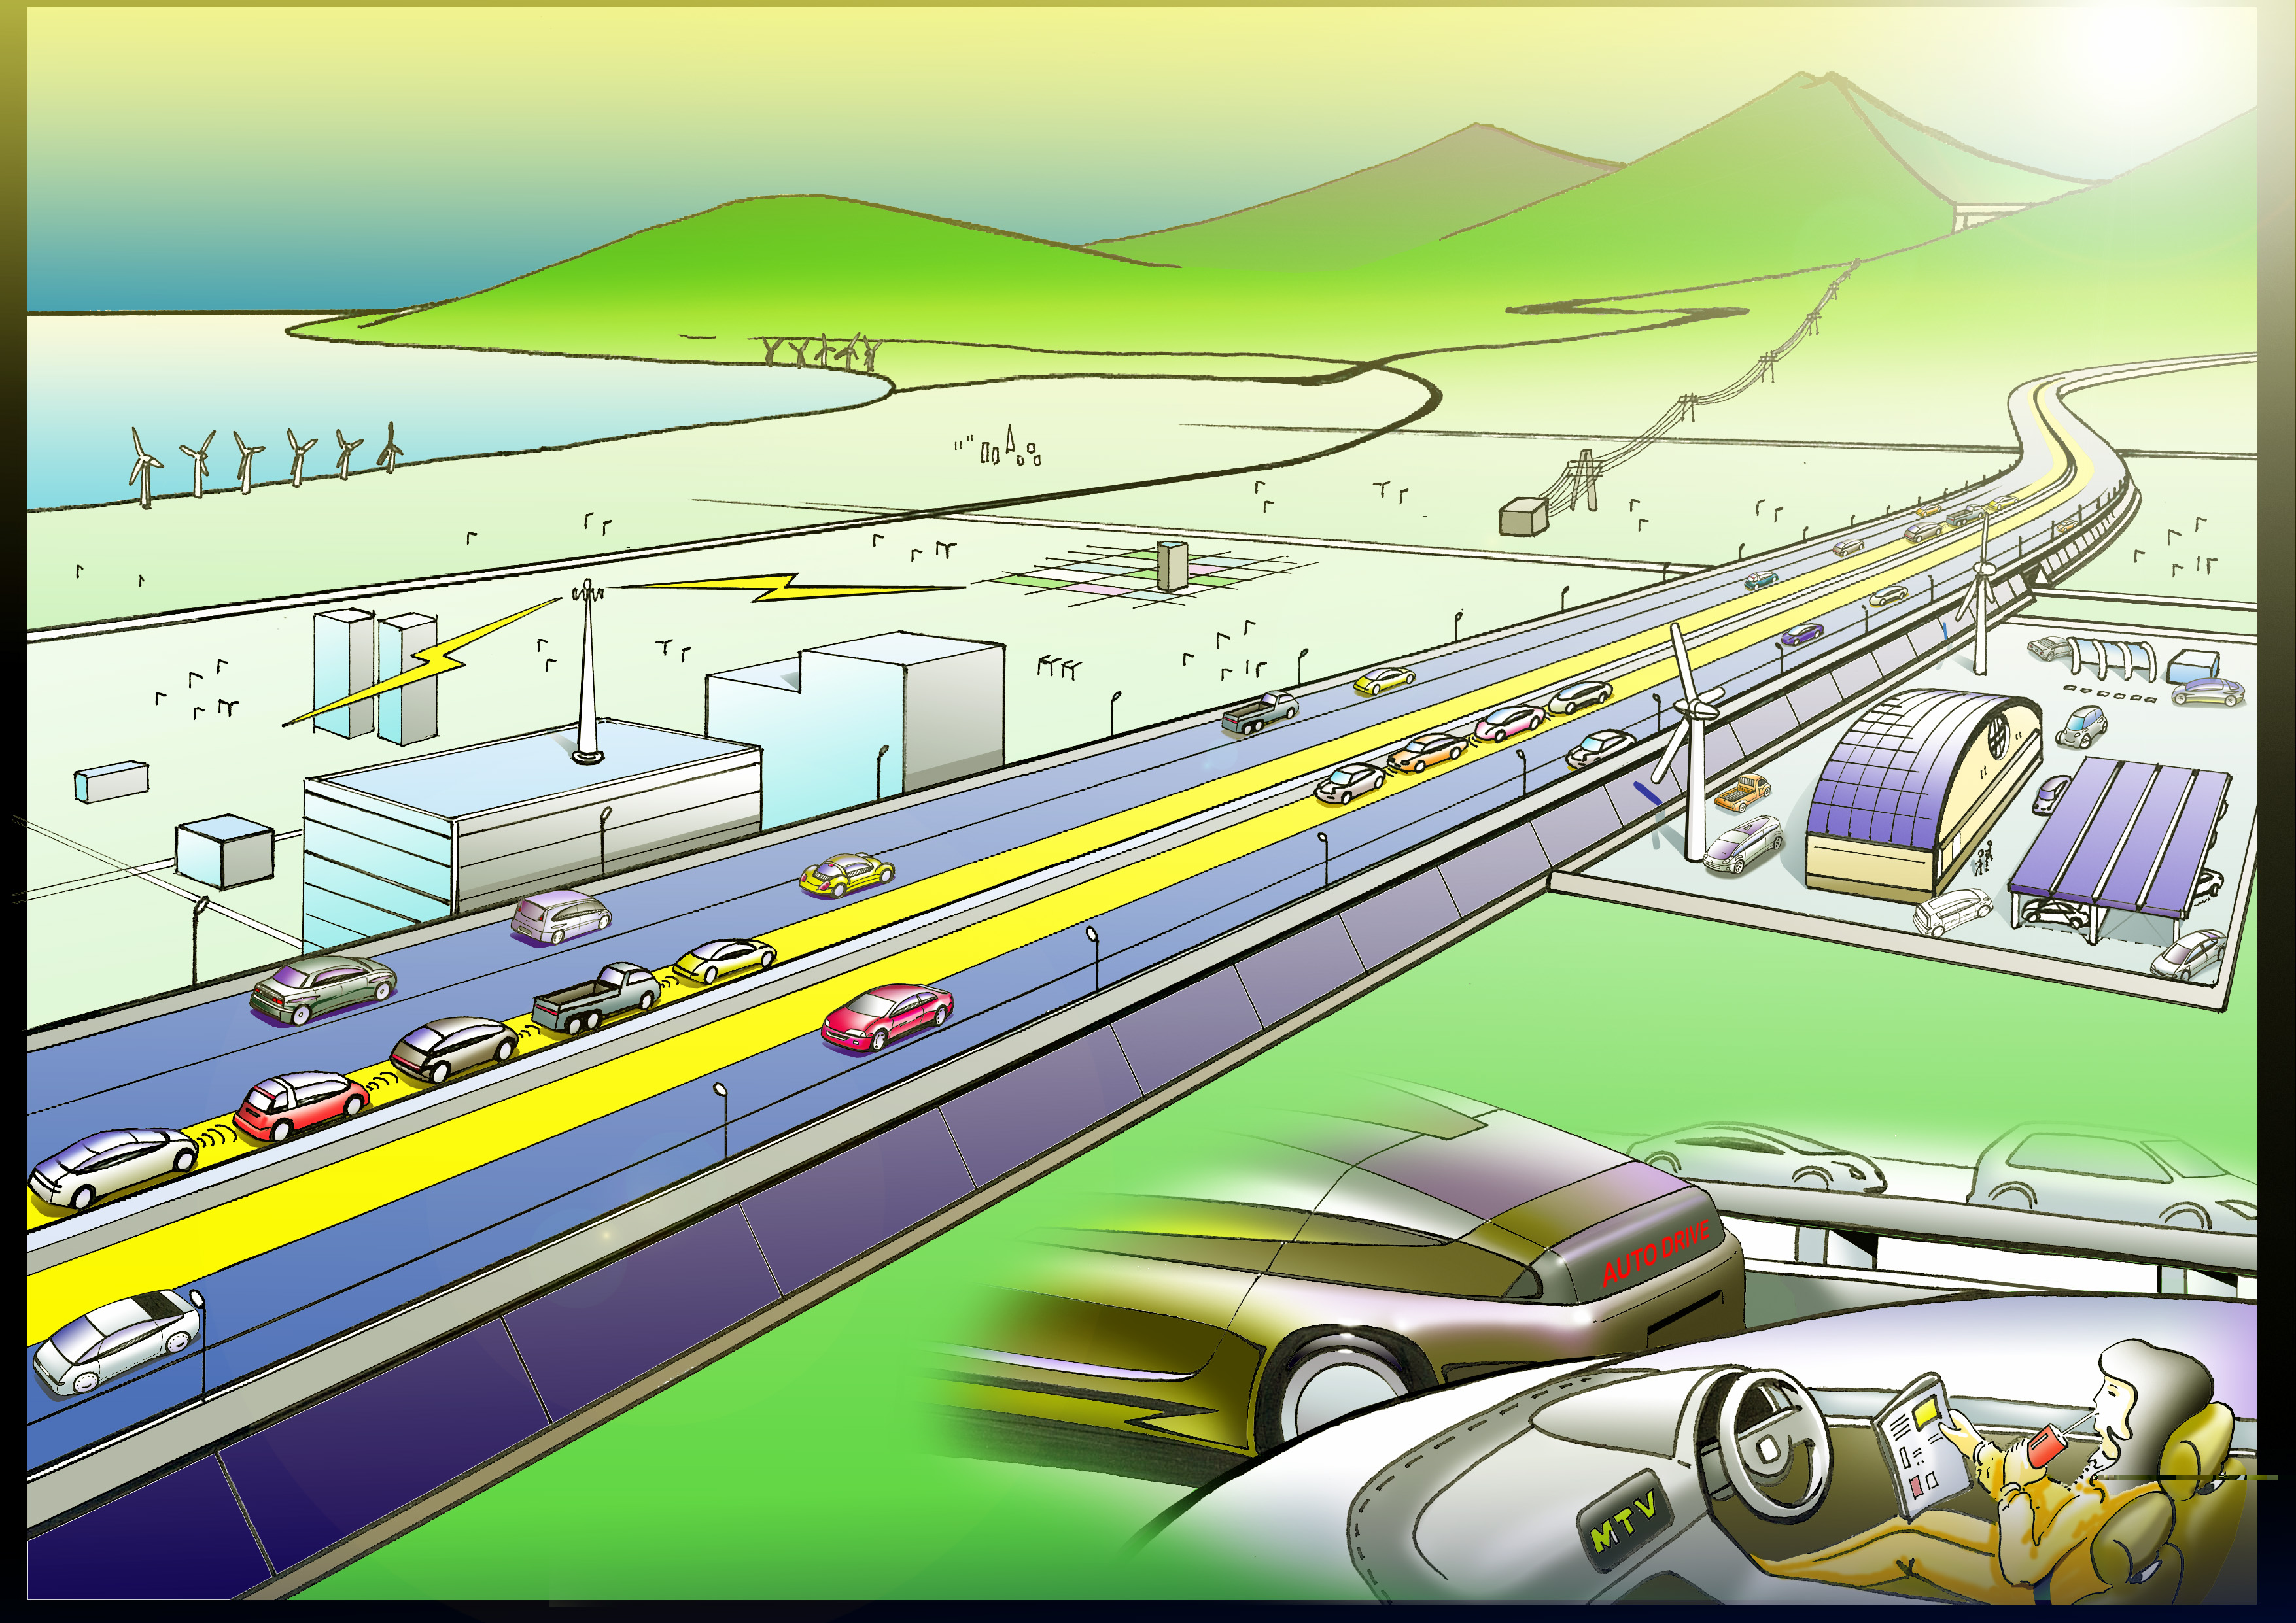
A Vision of Future Sustainable Mobility
Wind-generated electricity
Hydro- power electricity
Hydrogen
refueling
station
Road-to-vehicle
communication
Intervehicular
communication
Automated Platoon Driving
Solar panels
E-Charge Lane
Electricity charge lane
Notes:
30
Go along with graph of Future (2010-2050 graph?)
- Good slide to end on

Slide 31
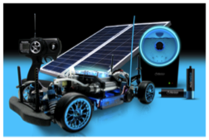
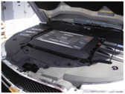
Contact Information
Woodrow Clark II, MA³, Ph.D.
Qualitative Economist
Managing Director
Clark Strategic Partners
PO Box #17975
Beverly Hills, CA
USA 90209
Email: wwclark13@gmail.com
Direct Line +1 (310) 858-6886
Fax Line +1 (310) 858-6881
Web site: www.clarkstrategicpartners.net

