Slide 1
Mike Nasi
Jackson Walker L.L.P.
mnasi@jw.com • 512.236.2216
EPA’s War on Science
20th Annual International Energy Policy Conference
Oklahoma City, OK
October 25, 2012

Slide 2
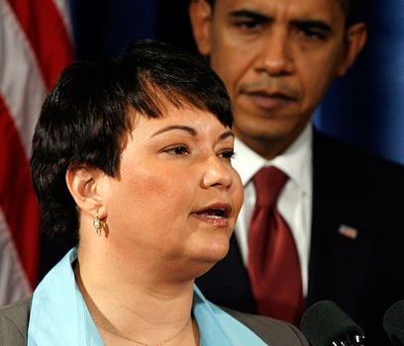
Our Nation’s Top Environmental Official
“We are actually at the point in many areas of the country . . . The best advice is don’t go outside. Don’t breathe the air. It might kill you.”
EPA Administrator Lisa Jackson on Real Time with Bill Maher
“If we could reduce particulate matter [pollution] to levels that are healthy, it would have identical impacts to finding a cure for cancer.”
EPA Administrator Lisa Jackson before the House Energy and Commerce Committee, 9/22/11

Slide 3
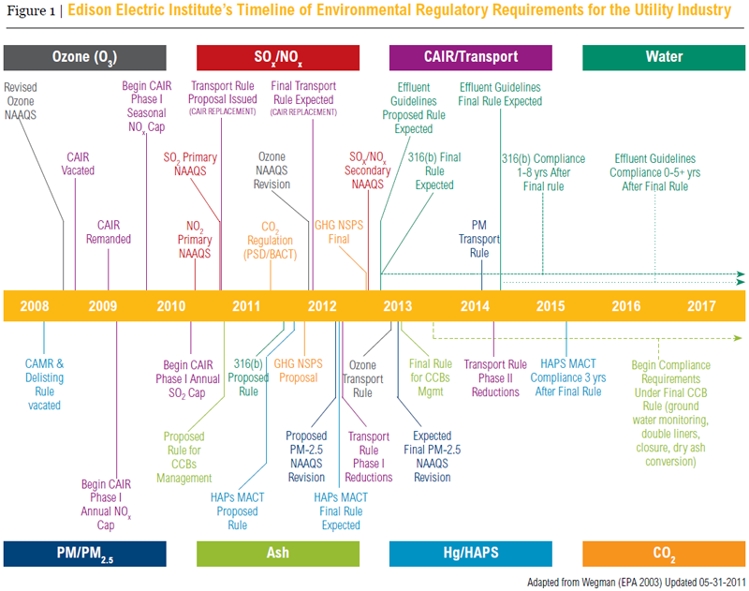
Q: What is the Source of this Mess?

Slide 4
A: Fatally-Flawed Cost/Benefit Analyses
No Risk is Too Low
Lack of Causal Relationship
Vastly Overstated Value of Statistical Lives
Benefits are Double & Triple-Counted
Contradictory Studies Ignored
Use of Models, Not Monitors, Ignores Reality

Slide 5
When are Cost/Benefit Analyses Required?
Some, but not enough, federal and state statutes require this (not NAAAQS)
Regulatory Impact Analyses (RIAs)
Executive Order 13563 (all significant regs)
OMB circular A4, 09/2003 (benefits must be likely and justify costs [or ID the most cost-effective alternatives]
Sadly not governed by same public comment / review / justification standards
5

Slide 6
A: Fatally-Flawed Cost/Benefit Analyses
No Risk is Too Low
Lack of Causal Relationship
Vastly Overstated Value of Statistical Lives
Benefits are Double & Triple-Counted
Contradictory Studies Ignored
Use of Models, Not Monitors, Ignores Reality

Slide 7
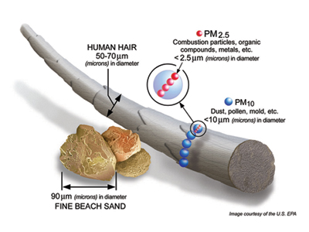
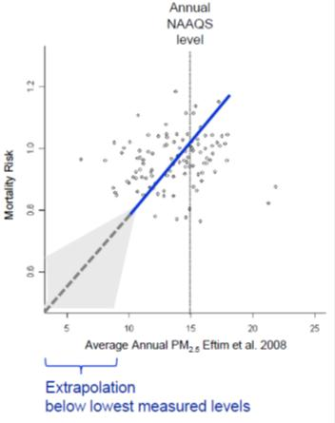
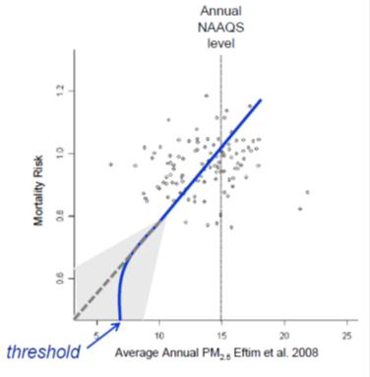
No-Threshold Impact Analysis
EPA assumes no safe level of PM_{2.5.}
“no threshold linear regression to zero analytic model.”
Source: Honeycutt.
No-Threshold Model
Model of What Threshold Could Be

Slide 8
Effect of Changed Science
In 2009, estimates dramatically jumped to 320,000 deaths per year
This represents 13% of all deaths in U.S.
Absurd results shown by how this compares to how many people die /year from common causes:
600,000 from heart disease & cancer
32,000 from traffic accidents
137,000 from actual respiratory disease (this proves the whole point – where are the extra bodies??
Source: Michael Honeycutt, Ph.D & Stephanie Shirley, Ph.D., Understanding How EPA Clean Air Rules Are Derived: A brief overview of benefit cost analysis, September 25, 2012. and Stephen Minick, EPA Cost Benefit Analysis Re-assessing the Justification for Environmental Rules (citing: http://www.cdc.gov/nchs/data/nvsr/nvsr60/nvsr60_04.pdf)

Slide 9
A: Fatally-Flawed Cost/Benefit Analyses
No Risk is Too Low
Lack of Causal Relationship
Vastly Overstated Value of Statistical Lives
Benefits are Double & Triple-Counted
Contradictory Studies Ignored
Use of Models, Not Monitors, Ignores Reality

Slide 10
Reference Manual on Scientific Evidence (3d Ed. 2011)
“In general, studies that find a relative risk less than 2.0 should not be sufficient for causation . . . [r]elative risks of less than 2.0 may readily reflect some unperceived bias for confounding factor . . . If the relative risk is near 2.0, problems of bias and confounding in the underlying epidemiologic studies may be serious, perhaps intractable.”

Slide 11
EPA Causation Violates International & Evidentiary Stds

Slide 12
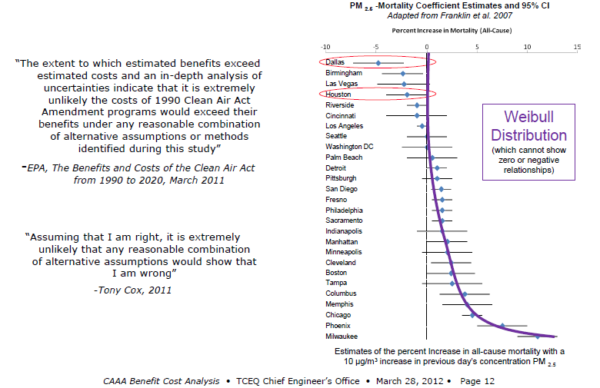
EPA’s Causation Dog Don’t Hunt
Yet, EPA asserts that 5-6% of all deaths in Texas are caused by PM2.5

Slide 13
A: Fatally-Flawed Cost/Benefit Analyses
No Risk is Too Low
Lack of Causal Relationship
Vastly Overstated Value of Statistical Lives
Benefits are Double & Triple-Counted
Contradictory Studies Ignored
Use of Models, Not Monitors, Ignores Reality

Slide 14
“Value of Statistical Life”
A statistical life is an aggregation of small risk reductions across many individuals until aggregate reflects total of one life.
Used as a way to quantify income v. risk reduction – the willingness to pay for small risk reductions across a large number of people (that they wouldn’t pay)
Yet, EPA applies a $8.9 million value to “every life saved” (leads to flawed benefit calculation of $2 Trillion instead of $19 Billion (<$65 billion cost)
Source: Honeycutt, Understanding Clean Air Rules.

Slide 15
A: Fatally-Flawed Cost/Benefit Analyses
No Risk is Too Low
Lack of Causal Relationship
Vastly Overstated Value of Statistical Lives
Benefits are Double & Triple-Counted
Contradictory Studies Ignored
Use of Models, Not Monitors, Ignores Reality

Slide 16
Double- and Triple-Counting Benefits
PM_{2.5} is the primary source of alleged “benefits” in EPA Cost/Benefit Analyses
For some rules, PM_{2.5} represent all, or virtually all, of all quantified benefits (e.g. MATS)
PM = 95% of assumed public health benefits in all EPA rulemaking (1990-2020)
99% of that 95% came from benefits assumed below current NAAQS (without changing it)

Slide 17
A: Fatally-Flawed Cost/Benefit Analyses
No Risk is Too Low
Lack of Causal Relationship
Vastly Overstated Value of Statistical Lives
Benefits are Double & Triple-Counted
Contradictory Studies Ignored
Use of Models, Not Monitors, Ignores Reality

Slide 18
EPA Ignores Studies Showing No Association Between PM_{2.5} and Mortality
Lipfert et al. 2000, 2006, 2008, 2009
McDonnell et al. 2000
Chen et al. 2005 (for males)
Enstrom 2005 (California)
Laden et al. 2006 (1990-1998) – Harvard Six Cities Cohort
Franklin et al 2007 (for West)
Zeger et al. 2008 (for West)
Krewski et al. 2009 (1972-2000) – Am. Cancer Society Cohort
Cox 2001
Source: Honeycutt.

Slide 19
A: Fatally-Flawed Cost/Benefit Analyses
No Risk is Too Low
Lack of Causal Relationship
Vastly Overstated Value of Statistical Lives
Benefits are Double & Triple-Counted
Contradictory Studies Ignored
Use of Models, Not Monitors, Ignores Reality

Slide 20
Unrealistic & Flawed Models Undermine EPA Evaluation of Regional Reliability
CSAPR - Inflated view of load carrying capacity of wind (EPA assumes 100% while ERCOT documents 8.7%).
No analysis of cumulative impact of multiple rules:
CSAPR
MATS retrofits/retirements and potential block on new units
CWA 316(b) (ERCOT study shows 11 GW of retirements in TX by 2016 (1,200 MW of coal, 9,800 MW of gas))
CCR (if Sub. C = game over)
BART
Greenhouse Gas

Slide 21
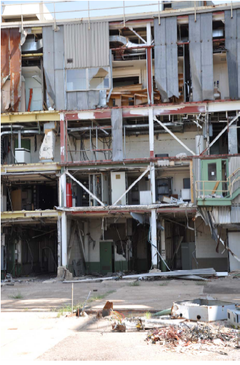
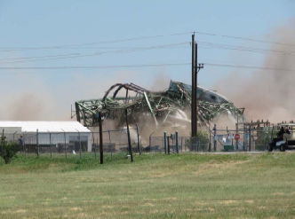
CSAPR Available Units
Reductions required in August 8, 2011 Final Rule prior to adjustments.

Slide 22
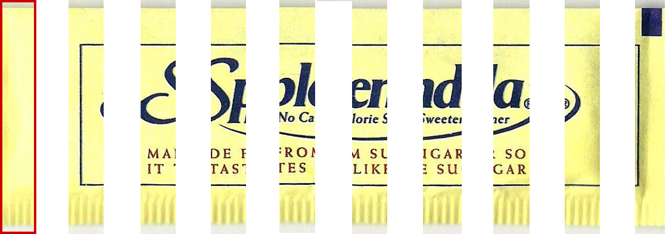
Poster Child of EPA Junk Science: CSAPR
EPA found anything over .15 micrograms/m³ to be a “significant contribution.”
Assuming that a single human being inhaled the maximum amount of exterior air, every day of a 70 year lifetime, that person would breath in less than 91 milligrams.
How small is 91 milligrams?
If you take a package of Splenda and sprinkle it on the table, dividing it into ten piles, each of those piles would be about 100 milligrams.
So, in a lifetime, what is being modeled as “significant” contribution to a worst-case receptor would be less than one tenth of a Splenda packet.

Slide 23
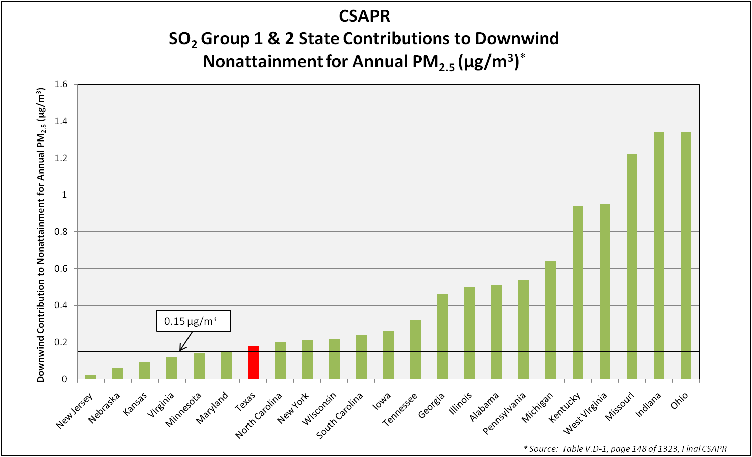
Alleged SO2 “Significant Contribution(s)”
in CSAPR
Reductions required in August 8, 2011 Final Rule prior to technical adjustments.
Source: Table V.D-1, Federal Register/Vol. 76, No. 152, page 48240
Notes:
23

Slide 24
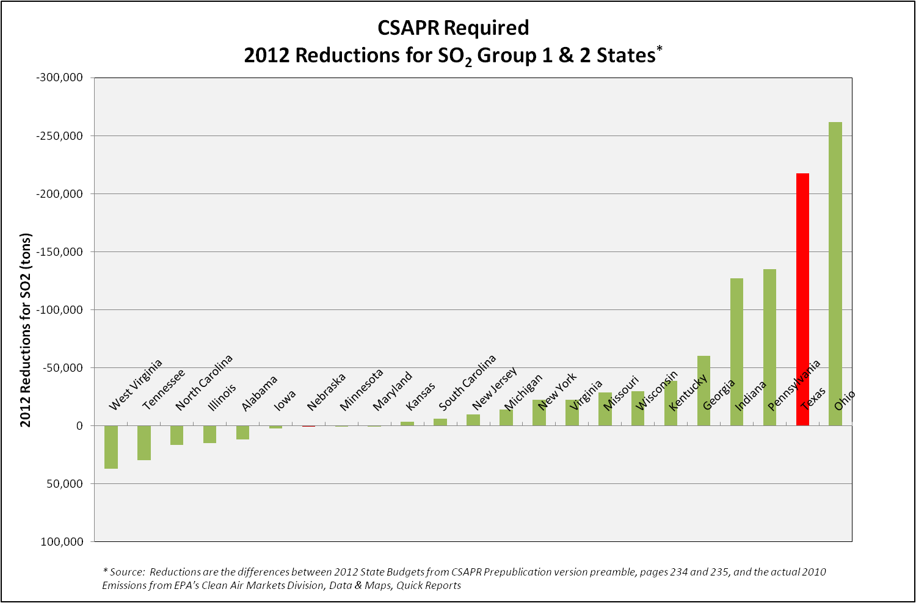
Required Share(s) of the Mandated
CSAPR SO2 Reductions
Reductions required in August 8, 2011 Final Rule prior to technical adjustments.
Source: Reductions are the differences between 2012 state budgets from Federal Register/Vol. 76, No. 152, pages 48261 and 48262, and the actual 2010 emissions from EPA’s Clean Air Markets Division, Data & Maps, Quick Reports
Notes:
24

Slide 25
Why the War on Junk Science Must Be Fought . . . AND WON
Using models, instead of monitors, increases costs with little-to-no real world benefits
Calculated benefits are dramatically overstated ($2 trillion, rather than $19 billion)
So, in turn, significant costs are justified (e.g., $65 billion)
By “reducing risk to zero”, our economy is being unilaterally disarmed (and emissions shifted)

Slide 26
THE STAKES ARE VERY HIGH – Significant Electricity Cost Increases Projected to Result From EPA Regulations
W
A
MT
(10)
ND
(27)
MN
(7)
ME
SD
(12)
WI
(21)
VT
OR
ID
NH
(8)
WY
(26)
MI
(19)
N
Y
NE
(27)
IA
(32)
M
A
PA
(8)
CT
RI
NV
IL
(18)
IN
(23)
OH
(12)
NJ
UT
CO
(11)
KS
(15)
MO
(23)
WV
(28)
MD
(5)
DE
(10)
C
A
KY
(13)
VA
(9)
OK
(19)
AR
(16)
TN
(12)
NC
(7)
AZ
NM
(6)
SC
(8)
MS
(8)
AL
(14)
GA
(10)
TX
(5)
LA
(6)
Projected Percent Increase in Price of Electricity
F
L
20% - 30%+
10% - 20%
(%) = State projected percent increase in price of electricity
Source: Burns & McDonnell Analysis (December 2010).
5% - 10%
<5%
Notes:
26

Slide 27
Regulation | Compliance Cost | Job Loss
Ozone | $1.013 trillion annually between 2020-30 | 7.3 million by 2020 (4.3% of labor force).
Boiler MACT | CIBO: At least $15 billion for capital, plus billions more in operating costs. | CIBO: More than 240,000 jobs at risk.
CSAPR | NERC: $120 billion. NERA: with Utility MACT, $184 billion (47.8 GW retired) | NERA: CSAPR and Utility MACT = loss of 1.44 million job-years by 2020.
Cooling Water Intake | Impacts up to 41GW of existing capacity (coal/nuclear/gas) 347+ units. Initial capital costs estimated at $64 billion. | Not yet clear , but obviously a great deal of power plant jobs at risk.
MACT for power plants (MATS) | EPA says $10 billion. NERC: $70-$100 billion. NERA: with Utility MACT, $184 billion (47.8 GW retired) | NERA: CSAPR and Utility MACT = loss of 1.44 million job-years by 2020.
Coal Ash | USWAG: costs range from $22-$110 billion (depending upon Subtitle D v. C) | USWAG: 39,000-316,000 jobs will be lost (depending upon Subtitle D v. C)
GHG Regs | UNQUANTIFIABLY LARGE, but PSD permits alone will cost $125,000; Title V imposes up to $250,000 carbon “fee” on applicants; NSPS will have devastating impacts if kept in place for new, let alone existing plants. | TBD, but it won’t be pretty because EPA is basically saying that no more coal plants can be built for the foreseeable future.
The Cost of EPA’s Overregulation

Slide 28
Impacts are not Just Dollars and Jobs - Grid Stability is at Stake in Many States
By 2016, only one in four states will be in a reliability region meeting NERC’s acceptable standards
Number of contiguous states in reliability regions where available capacity margin meets accepted level -- 15%
28
28
Source: Dr. Frank Clemente, Energy Realities Facing the United States.
Notes:
28

Slide 29
Coal-Based Electricity is not the Only Industry Under Siege
(it just feels that way)
29
Notes:
29

Slide 30
Their Own Numbers Prove the Point
Based on [GAO] data…and regulations published in the Federal Register, the Administration has published more than $488 billion in regulatory costs since January 20, 2009 – $70 billion in 2012 alone.
– American Action Forum, 2012
NOTE: range of estimates up to $1.8 Trillion!
The annual cost of federal regulations in the United States increased to more than $1.75 trillion in 2008. Had every U.S. household paid an equal share of the federal regulatory burden, each would have owed $15,586 in 2008.
– Small Business Administration, 2010

Slide 31
Bad Science = Absurd Numbers
Taking EPA numbers at face value, EPA is currently responsible for 87-95% of all Federal Benefits Imparted on the American People by the Administration.
Each of us has been given an additional 16 years thanks to the PM standard alone.
The credibility of public health decision-making is at stake!

