Slide 1
Drilling Outlook / U.S. Fracing
Water Usage
Kurt Abraham Executive Editor
World Oil magazine Gulf Publishing Company
20th Annual International Energy Policy Conference
Oklahoma City; Oct. 25, 2012
Notes:
2011 was certainly a year of growth and comeback for the oil and gas industry and we believe this trend will continue throughout 2012. We expect solid, moderate growth for the E&P sector, in most regions .

Slide 2
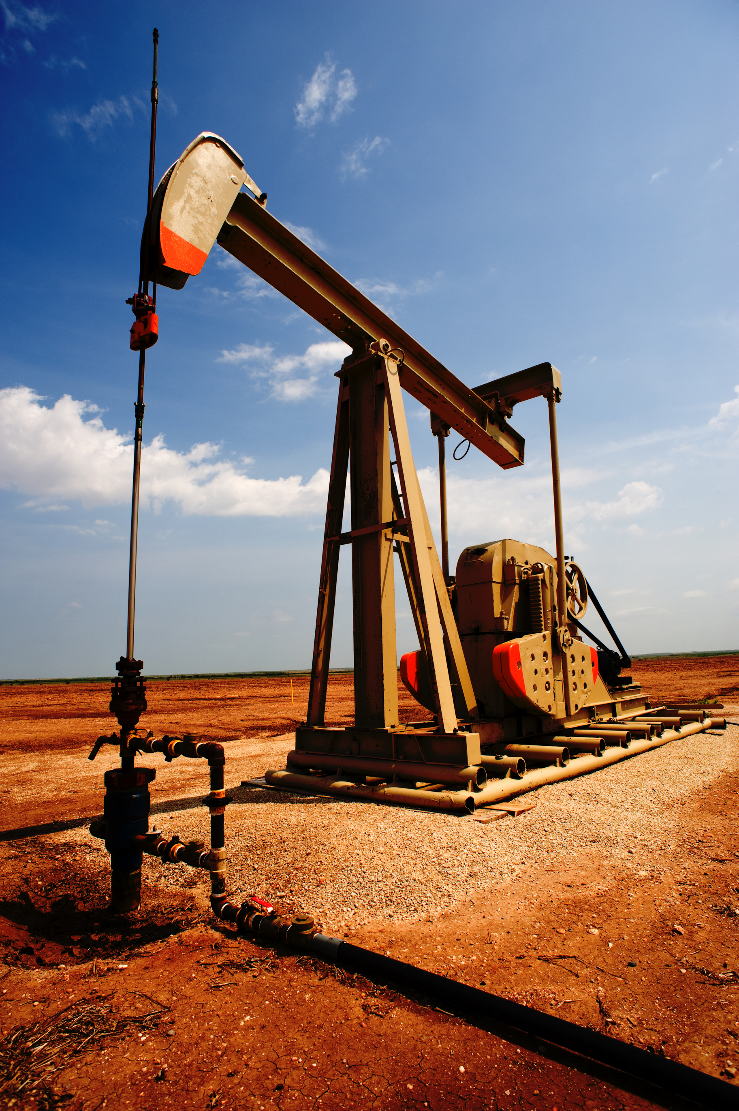
Oil Price, WTI Spot Average
EIA projects $93.00/bbl for 2H 2012, and $95.55 for full year 2012; and $92.63/bbl for 2013
World Oil: $93.25/bbl for 2H and $94.95 for full year 2012; and $93.15/bbl for 2013
Sources: EIA, 2007-2012
World Oil, 2012

Slide 3
U.S. Gas Price - Henry Hub
EIA orig. said $2.55 and now projects $2.71/Mcf for all of 2012, and $3.35 for 2013.
World Oil projects $2.69/Mcf in ‘12 and $3.29 for 2013.
Sources: EIA, 2006-2012
World Oil, 2012
Notes:
On the contrary, the natural gas price at the Henry Hub entered a down cycle in 2008. During 2011, the average price was $3.99 per thousand cubic feet. We expect that due to a reduction in gas-directed drilling, natural gas supply will contract, and therefore, the average price during 2012 will be $3.10/Mcf.

Slide 4
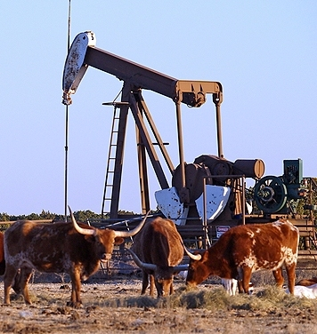
U.S. Domestic Crude Oil Production
2010: 5,495
2011: 5,605
Up 12.9% since 2010
Sources: EIA, 1990-2011
API & EIA, 2012
Notes:
High crude oil prices have provided the incentive for the reversal of U.S. oil production since 2008. In 2011, U.S. operators produced 5.6 million barrels of oil per day, an increase of 2.5% since 2010. This trend should continue in the short term, and maybe longer.

Slide 5
Oil/Gas Drilling Split in U.S.
Oil-directed rigs 59.4%, Dec. 2011
76.7%, Oct. 2012
Gas-directed rigs 40.3%, Dec. 2011
23.2% , Oct. 2012
Source: Baker Hughes
Notes:
The impact of oil and gas prices is quite evident in this chart, which shows the oil and gas drilling split. The U.S. used to be a haven for gas drilling, with about 80% of the rigs drilling for gas in 2001. At the end of 2011, nearly 60% of the rigs were drilling for oil. The percentage of oil-directed drilling is likely to go up even further in 2012.

Slide 6
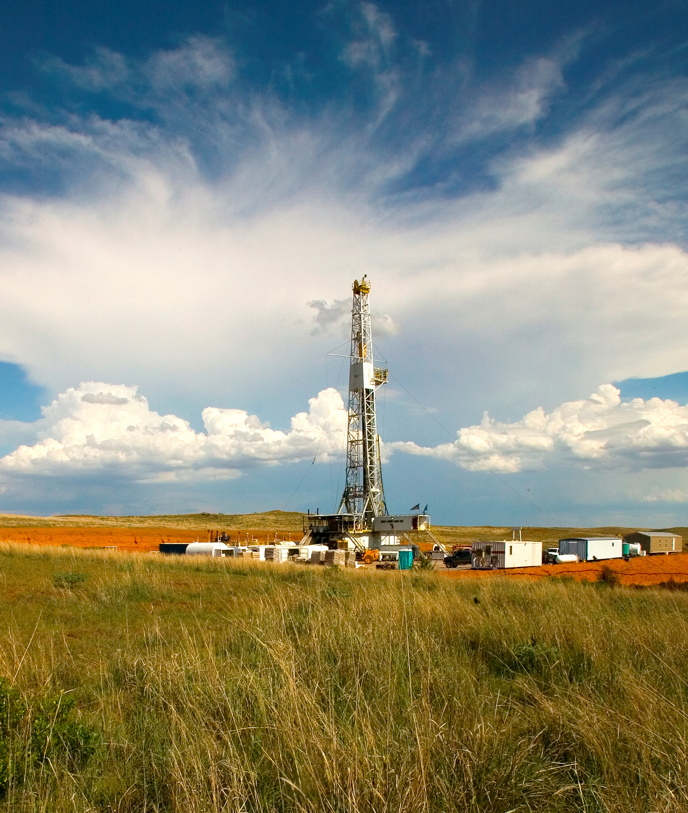
U.S. Wells Forecast
Up 1.5% in 2012 vs. 2011
23,770 wells in 2nd half 2012
vs. 22,492 wells in 1st half,
up 5.7%
Notes:
To arrive at our estimate of wells drilled in the U.S. during the past year, and our forecast for this year, we conduct surveys of state and federal agencies, and operators, and combine those results with rig counts and other data. Last year, U.S. operators drilled just under 45,000 wells. This year, we forecast that operators will drill close to 48,000 wells nationwide. This will be a gain of nearly 7%, or about half the growth rate of last year. It will also be the highest well total since the peak year of 2008. Most of the states will have some form of increase this year, although there are a few minor exceptions, and most of those are in states that are more dependent on gas production and drilling.

Slide 7
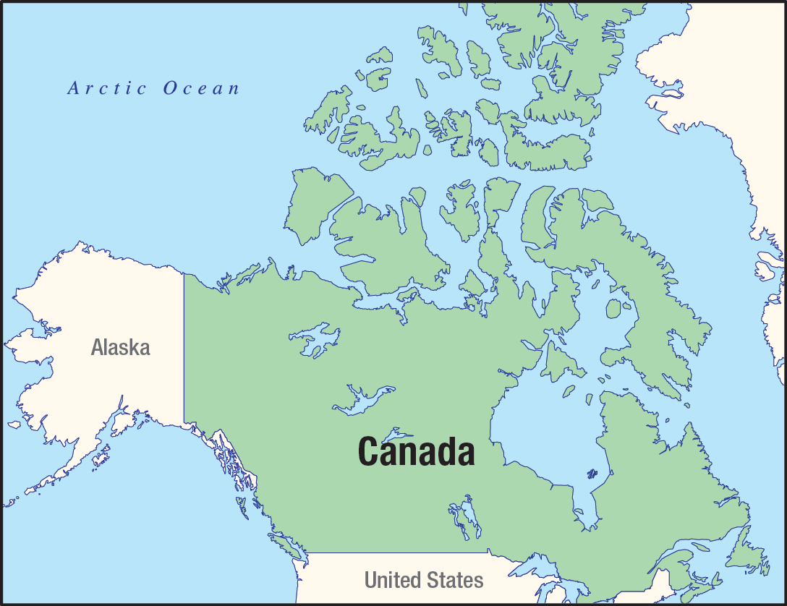
Canada
*Down 1.5% in 2012
Notes:
In Canada, oil is driving activity in a big way not seen since the 1996, when the well count was over 25,000. This is particularly true in Alberta, whose oil sand deposits now account for just over half of all Canadian crude production. Technological advances have prompted investment in shale and tight gas plays in British Columbia and Alberta.
TransCanada’s proposed Keystone XL pipeline, which would bring tar sands oil from Canada to refineries in Oklahoma and Texas, has been a hugely divisive issue. Last November, the State Department announced that the proposed route through Nebraska’s environmentally sensitive Sand Hills region required additional review, thus pushing the decision to 2013. While the Keystone issue could eventually curtail E&P activity, we do NOT believe it will have an effect in the short term.
For 2012, we forecast a 3.2% increase to 13,010 wells.

Slide 8
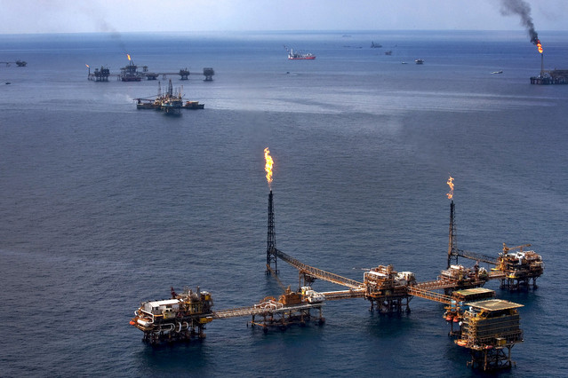
Mexico
*Up 3.4% in 2012
Notes:
In Mexico, E&P activity last year remained almost even with 2010’s level. Mexico in early 2011 held licensing rounds for performance-based contracts on oil blocks allowing participation by foreign oil companies, for the first time since the industry was nationalized in 1938. Foreign firms will have no ownership rights over any oil they produce, but they should infuse Mexican fields with improved technology. We expect a slight increase, to 1,150 wells, in 2012.

Slide 9
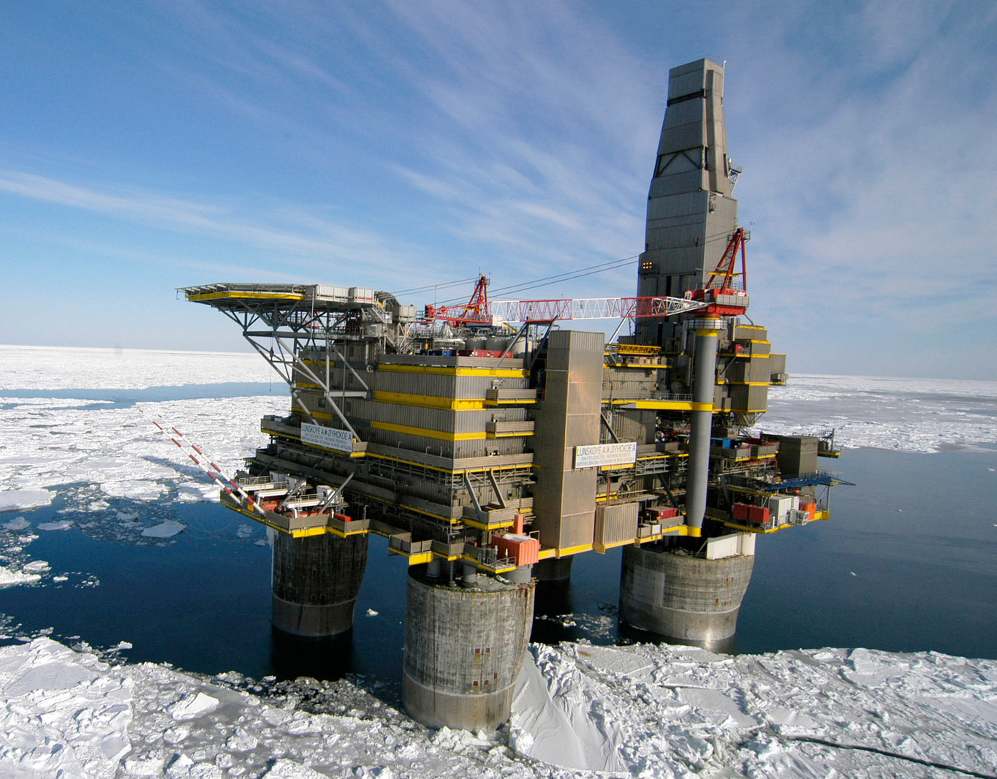
Rest of World – wells drilled (onshore and offshore, combined)
 | 2011 | 2012E*
So. America | 3,842 | 3,974
W. Europe | 577 | 537
FSU/E. Europe | 8,801 | 9,366
Africa | 1,432 | 1,623
Middle East | 2,599 | 2,749
Far East / So. Asia | 26,847 | 27,104
South Pacific | 257 | 293
Total | 44,355 | 45,646
Revised, Sept. 2012
Up 2.9% in 2012
Notes:
South America has remained a strong epicenter of E&P growth, with expanding activities in both deepwater and the discovery of vast shale plays at the southern tip of the continent. Across the region, drilling will be up nearly 11% this year, at 3,957 wells.

Slide 10
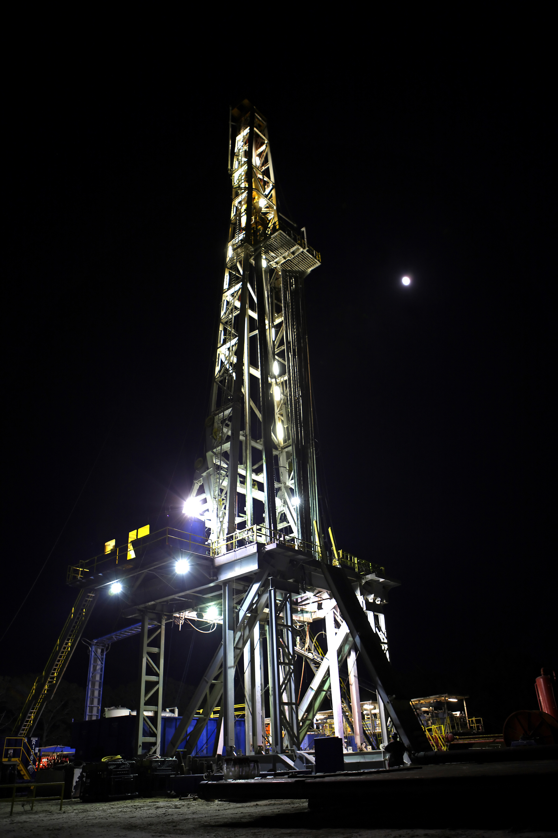
Average Number of Rigs in U.S.
*Up 2.6% in 2012 vs. 2011
Notes:
The Baker Hughes rig count continued to recover last year. The count was up 7.6%, for an average 1,877 rigs. The largest increases were in Texas District 8 and in North Dakota. District 8, of course, is home to the Permian Basin, and North Dakota is home to the Bakken Shale. The rig count in both Texas Districts 1 and 2 also more than doubled. Both of these areas are home to segments of the Eagle Ford Shale, where operators are exploiting the liquids portion of the play.

Slide 11
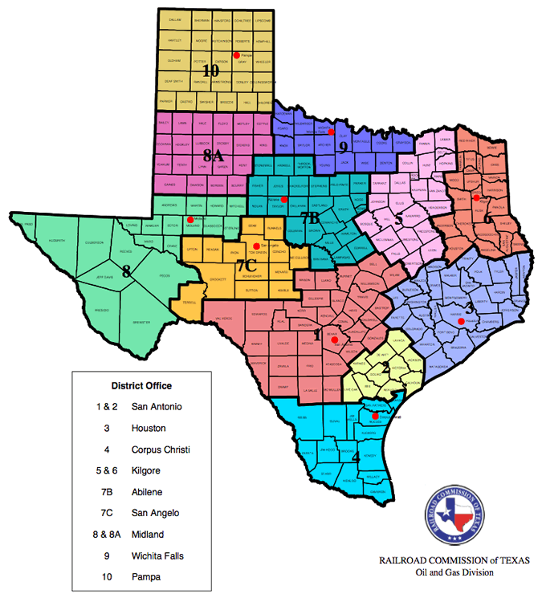
Drilling Activity Forecast
Wells drilled - Texas
Up 8.2% in 2012 vs. 2011
Up 4.3% from 1H ‘12 to 2H ‘12
Notes:
In Texas, activity rebounded to about 17,700 wells last year. Not only is that a substantial increase, but the total also is greater than what was drilled in Texas during the peak year of ‘08. This year, we expect more moderate growth of about 4%, but this will still push the total to above 18,000 wells, a number that we haven’t seen in a very long time. The biggest drilling increases will be in Districts One, Two, Four and Eight. Districts One, Two and Four, of course, are home to booming activity in the Eagle Ford Shale, and District Eight is in the center of the Permian Basin. By contrast, Districts Five and Nine, which contain the majority of the Barnett Shale, are going to have decreased activity this year, due to cutbacks in gas drilling.

Slide 12
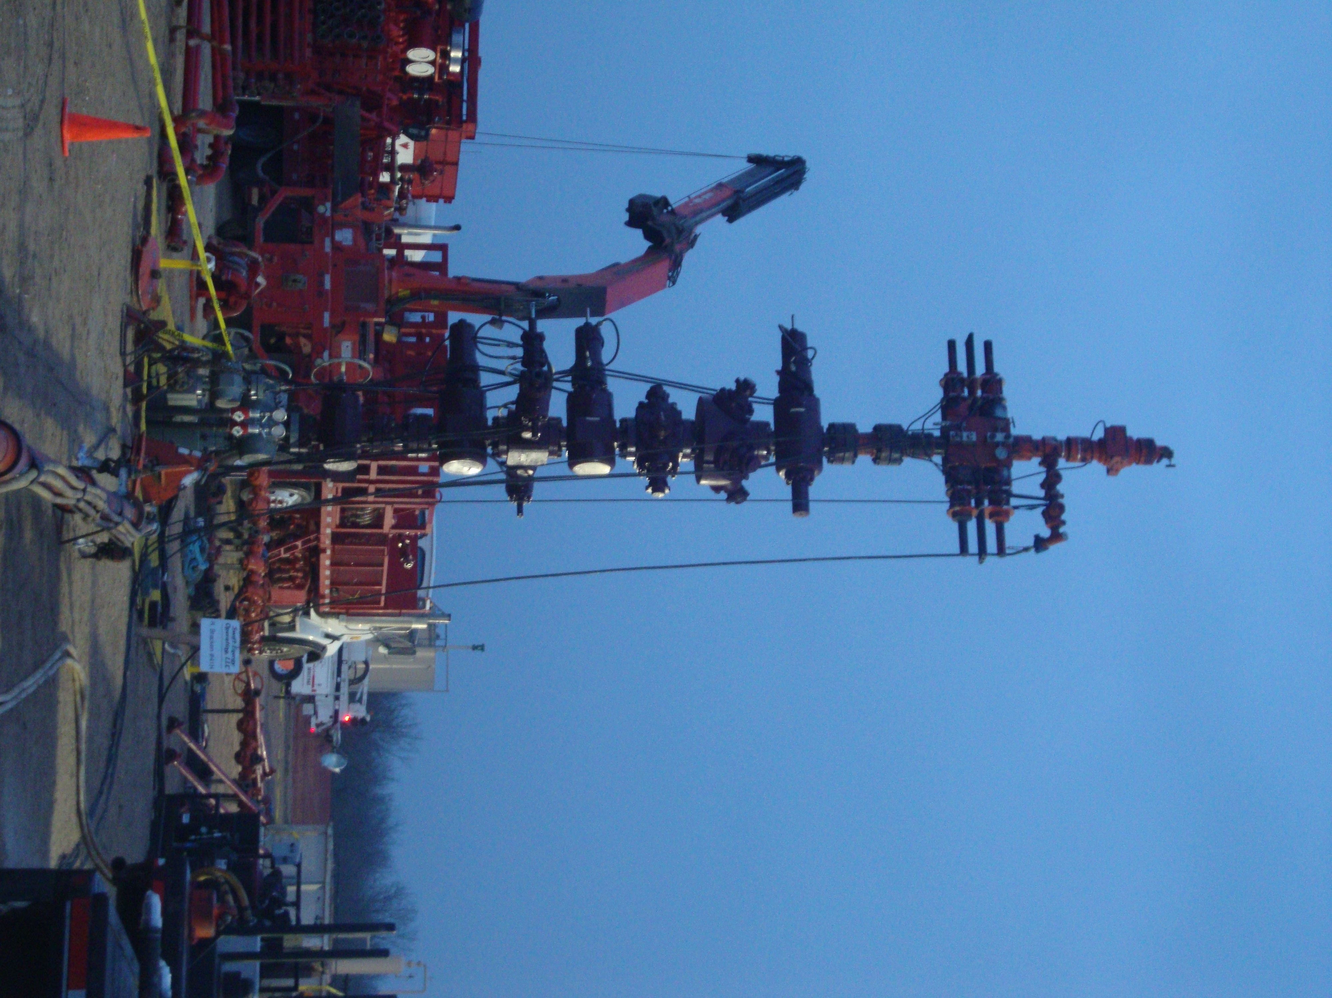
Shale Activity, 2012
Wells - Texas
 | Total rigs | Shale rigs | Total wells | Shale wells
Eagle Ford
District 1 | 137 | 134 | 2,083 | 2,037
District 2 | 79 | 71 | 974 | 875
District 4 | 46 | 25 | 696 | 380
Barnett District 5 | 20 | 8 | 718 | 287
District 7B | 15 | 6 | 1,059 | 424
District 7C | 78 | 2 | 2,005 | 51
District 9 | 26 | 25 | 1,290 | 1,240
Avg. Eagle Ford frac water usage; 3.5 million gal x 3,292 wells = 11.5 billion gal
Avg. Barnett frac water usage; 3.0 million gal x 2,002 wells = 6.01 billion gal
Notes:
Given what is happening in Northern Louisiana, it should be no surprise that the state, overall, will be down this year, with a 9% drop to about 1,350 wells. The overall drop is not as severe as that of the northern half, because Southern Louisiana will actually be up 10%. But keep in mind that the volume of wells drilled in the South is only about a third of that in the North. There is more oil drilling in the South, and that trend has been accelerating. Back in 2009, oil completions outnumbered gas completions about two-to-one. Last year, that ratio increased to about four-to-one.

Slide 13
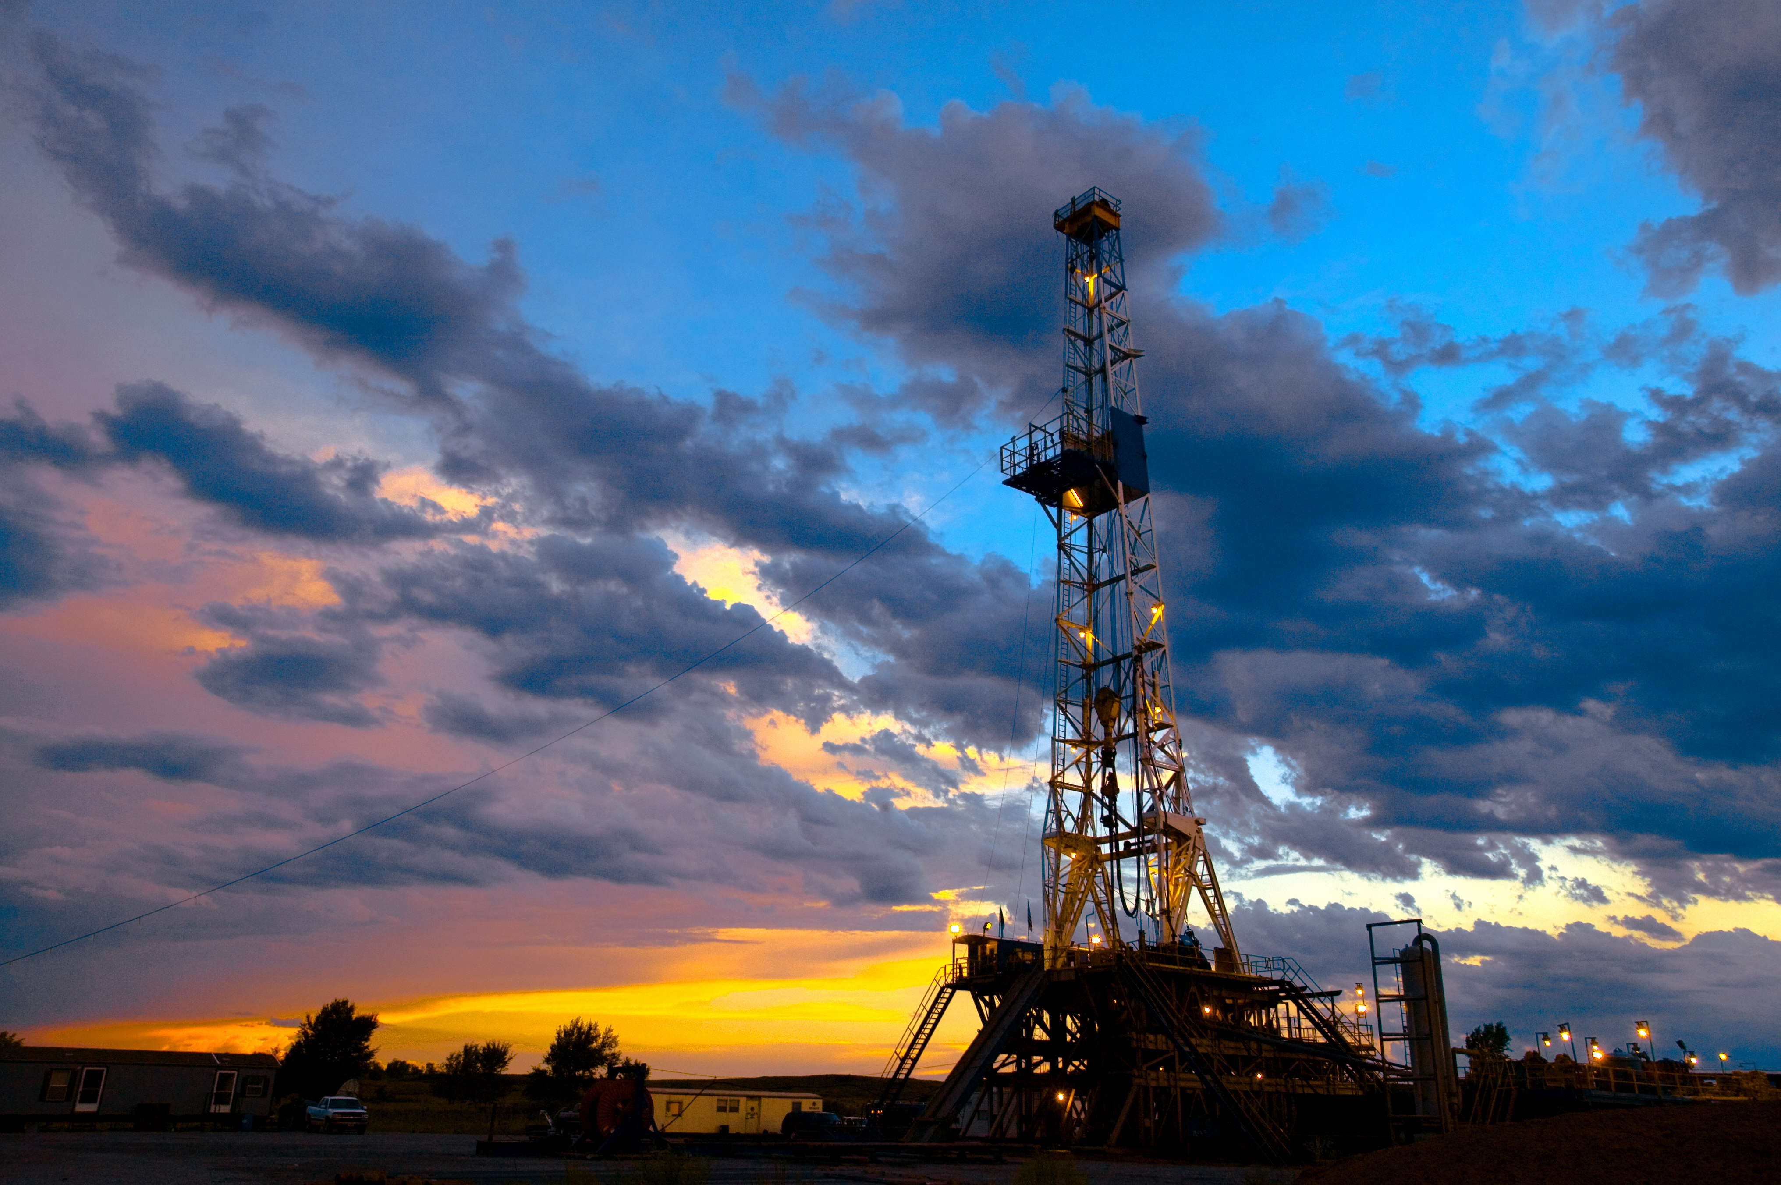
Onshore Drilling Activity Forecast
Wells drilled – Oklahoma
2011R | 2012R
3,467 | 3,814
Up 7.0% in 2012
1H ‘12 vs. 2H ’12:
Up 2.3%, at 1,885 wells in 1H
and 1,929 wells in 2H
Notes:
Given what is happening in Northern Louisiana, it should be no surprise that the state, overall, will be down this year, with a 9% drop to about 1,350 wells. The overall drop is not as severe as that of the northern half, because Southern Louisiana will actually be up 10%. But keep in mind that the volume of wells drilled in the South is only about a third of that in the North. There is more oil drilling in the South, and that trend has been accelerating. Back in 2009, oil completions outnumbered gas completions about two-to-one. Last year, that ratio increased to about four-to-one.

Slide 14
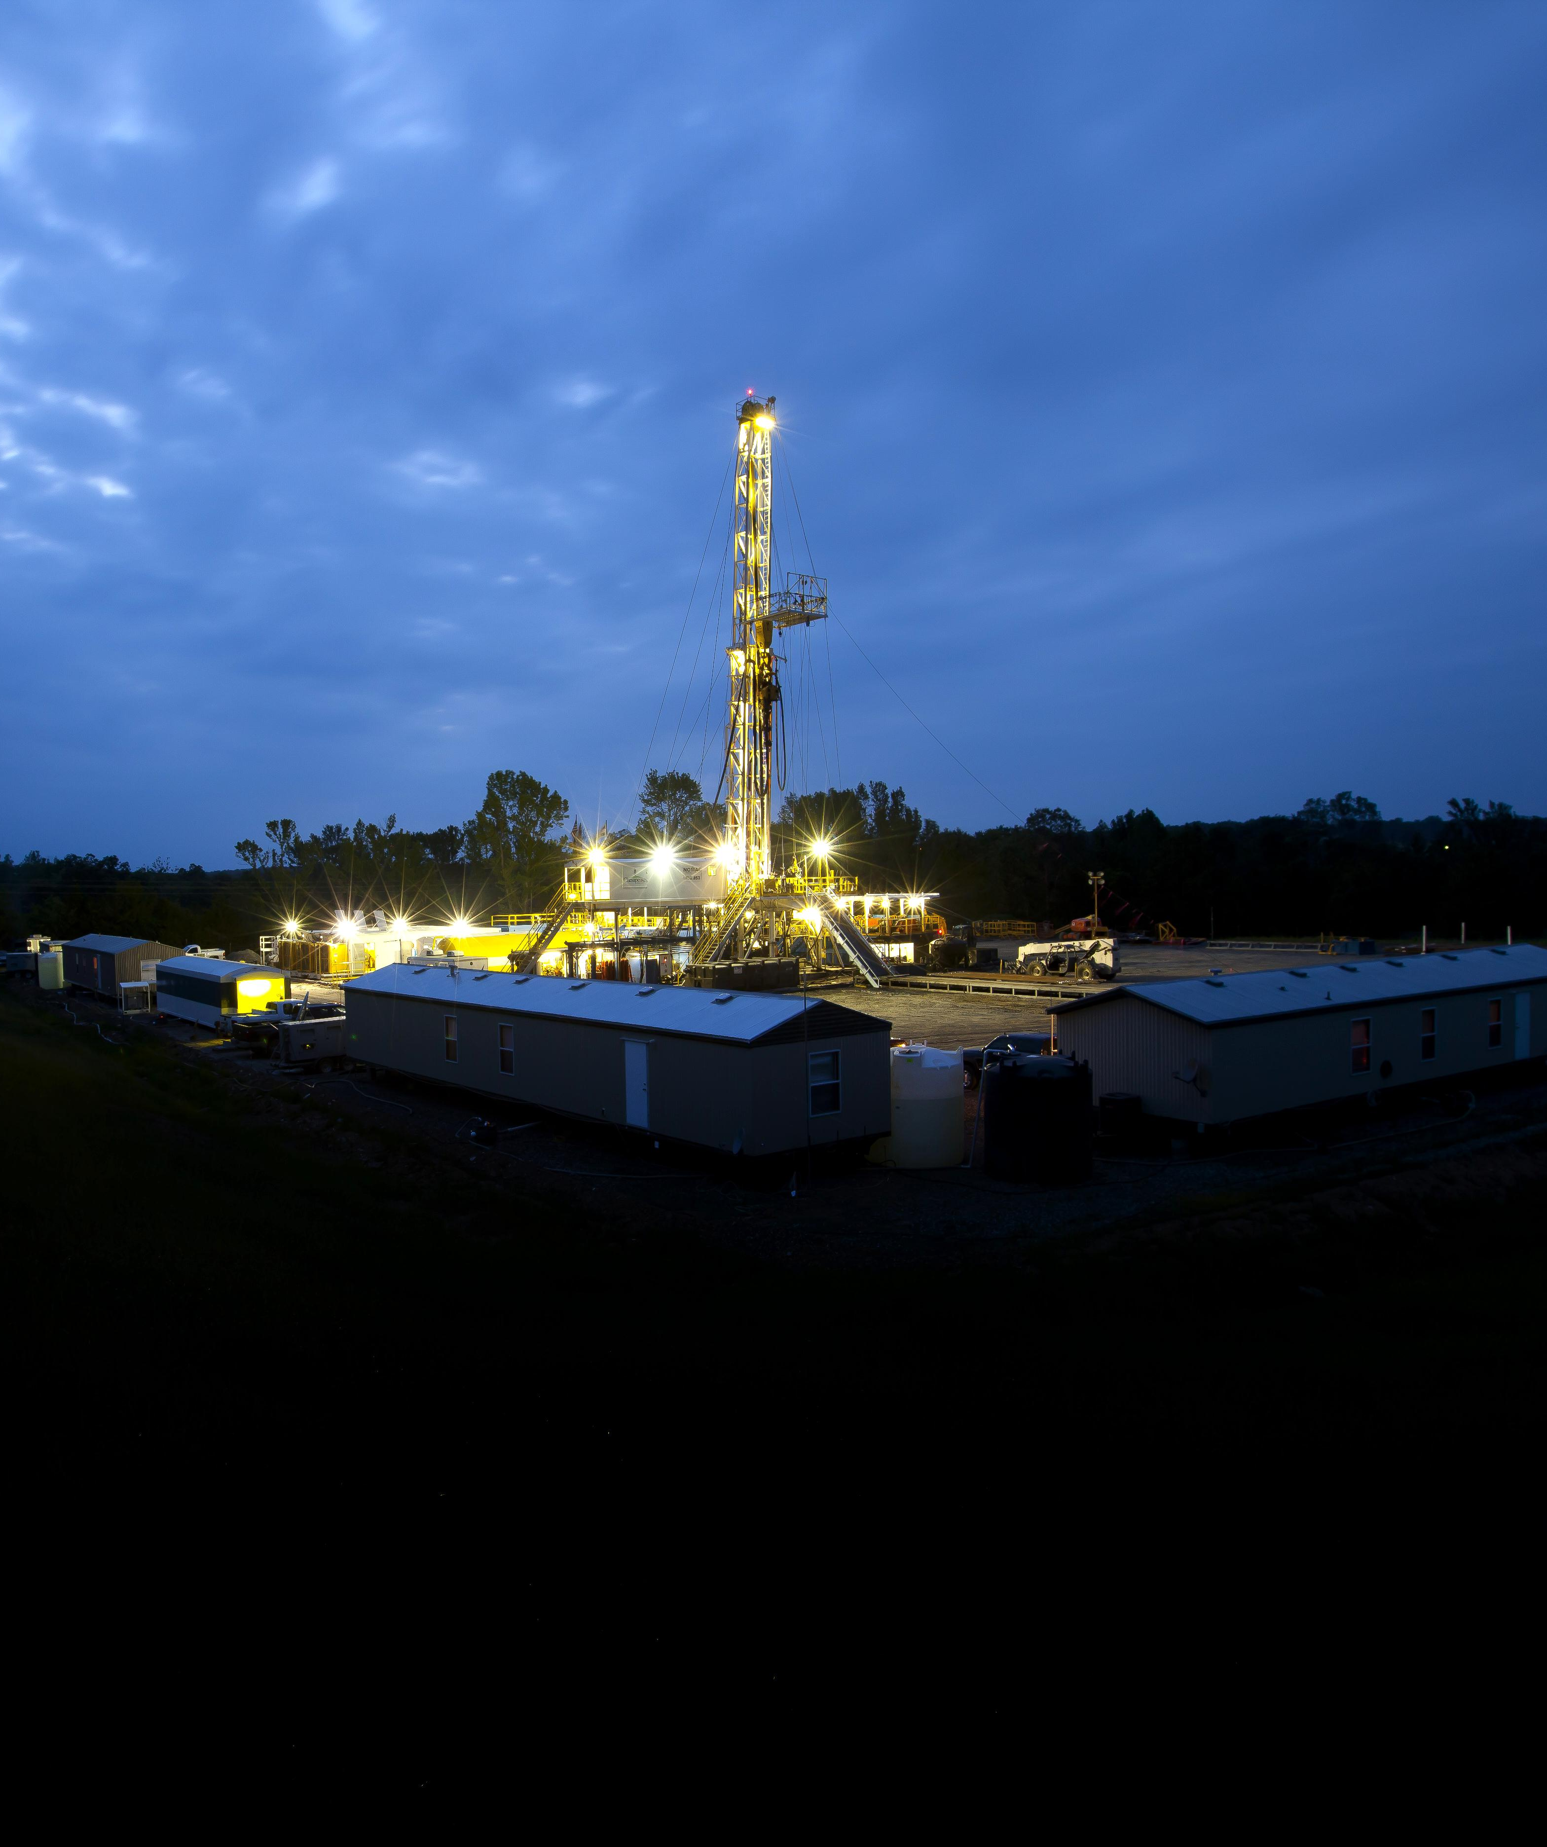
Shale Activity
Fayetteville shale (Ark.)
 | Total rigs | Shale rigs | Total wells | Shale wells
Fayetteville
Arkansas | 17 | 13 | 907 | 694
Avg. Fayetteville frac water usage; 4.3 million gal x 694 wells = 2.98 billion gal
Notes:
Given what is happening in Northern Louisiana, it should be no surprise that the state, overall, will be down this year, with a 9% drop to about 1,350 wells. The overall drop is not as severe as that of the northern half, because Southern Louisiana will actually be up 10%. But keep in mind that the volume of wells drilled in the South is only about a third of that in the North. There is more oil drilling in the South, and that trend has been accelerating. Back in 2009, oil completions outnumbered gas completions about two-to-one. Last year, that ratio increased to about four-to-one.

Slide 15
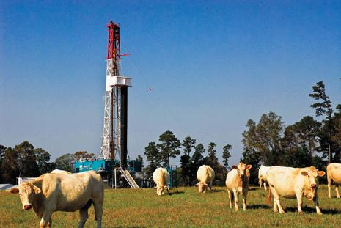
Onshore Drilling Activity Forecast
Wells drilled – Louisiana
2011R | 2012R
1,285 | 1,066
Down 17.0% in 2012
1H ‘12 vs. 2H ’12:
Down 16.8%, at 582 wells in 1H
and 484 wells in 2H
Notes:
Given what is happening in Northern Louisiana, it should be no surprise that the state, overall, will be down this year, with a 9% drop to about 1,350 wells. The overall drop is not as severe as that of the northern half, because Southern Louisiana will actually be up 10%. But keep in mind that the volume of wells drilled in the South is only about a third of that in the North. There is more oil drilling in the South, and that trend has been accelerating. Back in 2009, oil completions outnumbered gas completions about two-to-one. Last year, that ratio increased to about four-to-one.

Slide 16
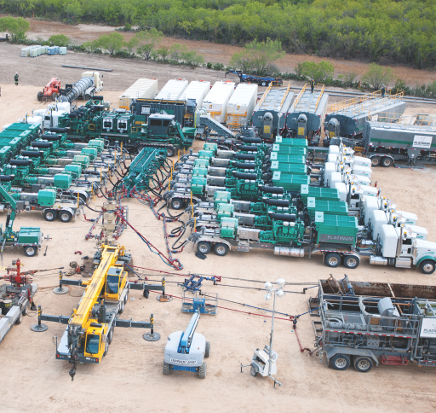
Shale Activity, 2012
Wells – LA/TX
 | Total rigs | Shale rigs | Total wells | Shale wells
Haynesville
Louisiana (N) | 25 | 17 | 512 | 348
Texas (Dist 6) | 26 | 19 | 442 | 323
Avg. Haynesville frac water usage; 5.0 million gal x 671 wells = 3.36 billion gal
Notes:
Given what is happening in Northern Louisiana, it should be no surprise that the state, overall, will be down this year, with a 9% drop to about 1,350 wells. The overall drop is not as severe as that of the northern half, because Southern Louisiana will actually be up 10%. But keep in mind that the volume of wells drilled in the South is only about a third of that in the North. There is more oil drilling in the South, and that trend has been accelerating. Back in 2009, oil completions outnumbered gas completions about two-to-one. Last year, that ratio increased to about four-to-one.

Slide 17
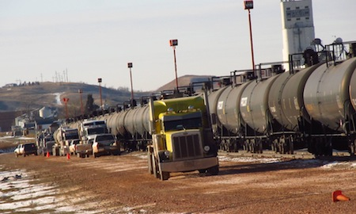
Onshore Drilling Activity Forecast
Wells drilled – North Dakota
2011R | 2012R
1,590 | 2,147
Up 35.0% in 2012
1H ‘12 vs. 2H ’12:
Up 13.2%, at 1,007wells in 1H
and 1,140 wells in 2H
Notes:
Given what is happening in Northern Louisiana, it should be no surprise that the state, overall, will be down this year, with a 9% drop to about 1,350 wells. The overall drop is not as severe as that of the northern half, because Southern Louisiana will actually be up 10%. But keep in mind that the volume of wells drilled in the South is only about a third of that in the North. There is more oil drilling in the South, and that trend has been accelerating. Back in 2009, oil completions outnumbered gas completions about two-to-one. Last year, that ratio increased to about four-to-one.

Slide 18
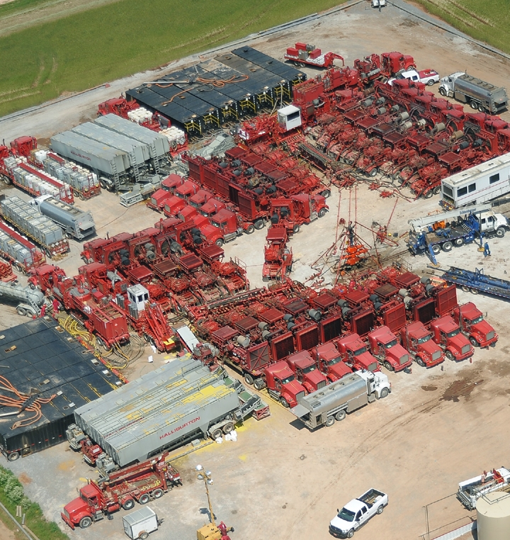
Shale Activity, 2012
Wells – North Dakota/Montana
 | Total rigs | Shale rigs | Total wells | Shale wells
Bakken
No. Dakota | 177 | 177 | 2,147 | 2,147
Montana | 26 | 25 | 310 | 295
Avg. Bakken frac water usage; 2.8 million gal x 2,442 wells = 6.84 billion gal
Notes:
Given what is happening in Northern Louisiana, it should be no surprise that the state, overall, will be down this year, with a 9% drop to about 1,350 wells. The overall drop is not as severe as that of the northern half, because Southern Louisiana will actually be up 10%. But keep in mind that the volume of wells drilled in the South is only about a third of that in the North. There is more oil drilling in the South, and that trend has been accelerating. Back in 2009, oil completions outnumbered gas completions about two-to-one. Last year, that ratio increased to about four-to-one.

Slide 19
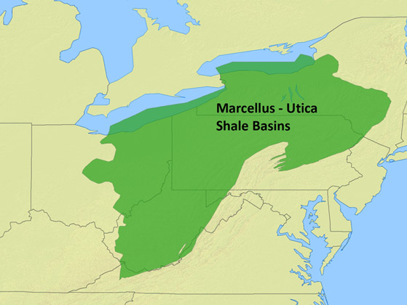
Drilling Activity Forecast
Penn., Ohio, NY and W. Virginia (Marcellus and Utica shales)
Up 2.2% in 2012
Notes:
Compared to some of the other shale plays, the situation remains relatively tough for the Marcellus, in Pennsylvania, Ohio, New York and West Virginia. All the negative factors that began to show up in late 2010 are still present now. These include low gas prices, concerns over water contamination from fracing—whether valid or not—and threats by federal, state and local officials to impose greater environmental regulation. When you put this all together, it’s no surprise that activity in New York state and West Virginia is down, at minus 3% and 5%, respectively. Pennsylvania has more diversified activity, so it will actually be up 2% this year. But in Ohio, where operators have figured out that they can ignore the Marcellus and take advantage of the oil-oriented Utica Shale play, drilling is expected to be up 40% this year. So, not all is lost in this region, at least outside of the Marcellus.

Slide 20
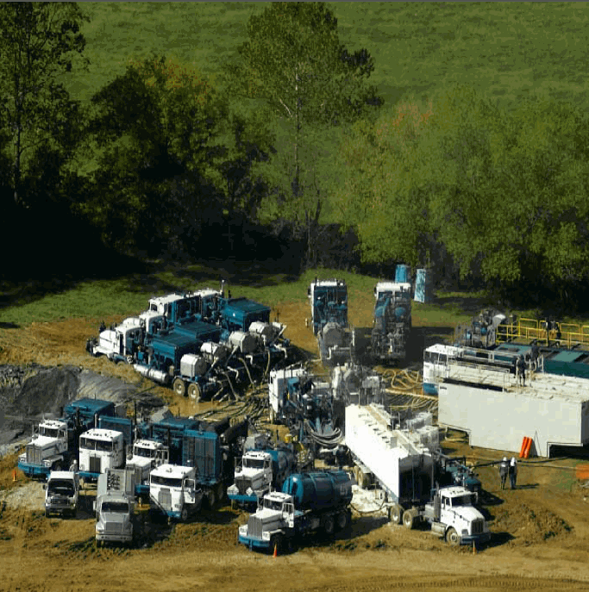
Shale Activity, 2012
Wells – PA/WV/OH
 | Total rigs | Shale rigs | Total wells | Shale wells
Marcellus
Pennsylvania | 63 | 63 | 1,978 | 1,915
West Virginia | 27 | 27 | 251 | 245
Utica Ohio | 23 | 23 | 594 | 570
Pennsylvania | 3 | 3 | 105 | 95
Avg. Marcellus frac water usage; 2.5 million gal x 2,160 wells = 5.4 billion gal
Avg. Utica frac water usage; 2.5 million gal x 665 wells = 1.66 billion gal
Notes:
Given what is happening in Northern Louisiana, it should be no surprise that the state, overall, will be down this year, with a 9% drop to about 1,350 wells. The overall drop is not as severe as that of the northern half, because Southern Louisiana will actually be up 10%. But keep in mind that the volume of wells drilled in the South is only about a third of that in the North. There is more oil drilling in the South, and that trend has been accelerating. Back in 2009, oil completions outnumbered gas completions about two-to-one. Last year, that ratio increased to about four-to-one.

Slide 21
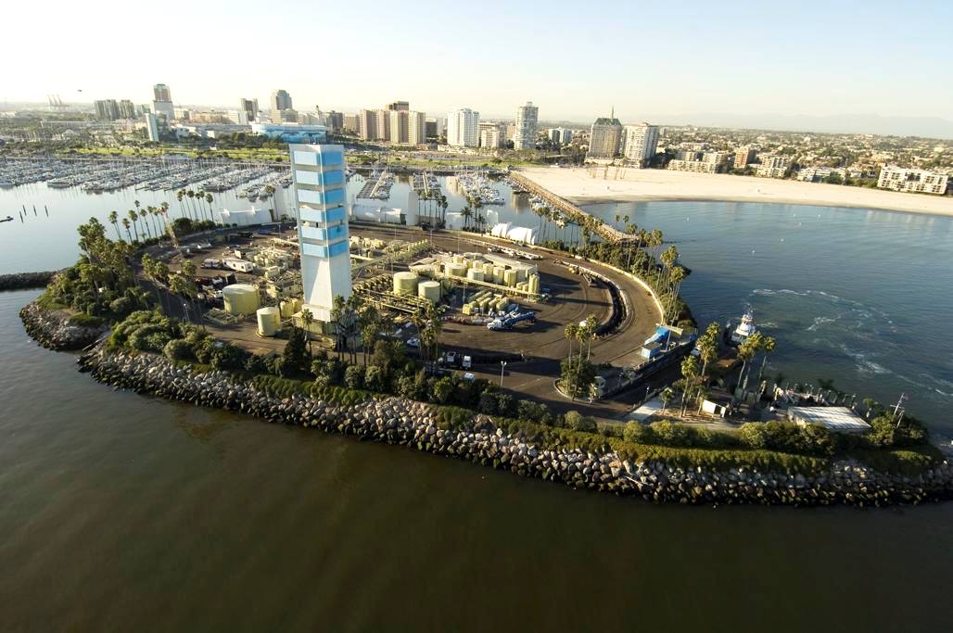
California (onshore)
Up 22.1% in 2012
Notes:
The picture is beginning to improve in California, where operators are rushing to take advantage of highly favorable oil prices. In particular, Occidental Petroleum is continuing a program begun last year to boost its California oil and gas production significantly by the year 2014. Most of this will be accomplished by drilling on existing assets. Furthermore, some other operators are also looking at how to take advantage of the Monterey Shale formation, where sizeable oil reserves are believed to exist. Overall, we expect California onshore drilling to be up 2% this year, at about 3,100 wells.

Slide 22
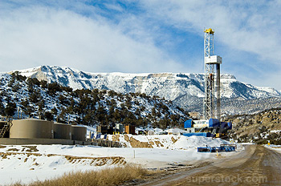
Colorado Including the Niobrara shale
2011R | 2012R
3,309 | 2,544
Down 23.1% in 2012
1H ‘12 vs. 2H ’12:
Up 8.1%, at 1,222wells in 1H
and 1,322 wells in 2H
Notes:
Across the Rocky Mountain states, activity is primarily in Colorado, Wyoming, New Mexico and Utah. As a group, these states will be up about 5%, to nearly 8,100 wells. However, the forecast varies some from state to state. For instance, Colorado will be up about 8%, and part of that is due to operators taking a look at the Niobrara play, and increasing their level of exploratory drilling. In Wyoming, gas drilling is still the majority of activity, but the ratio is switching toward oil. In New Mexico, the emphasis has switched to the southeastern half of the state, where far more opportunity exists to drill for oil, and away from the gas-prone northwestern half. But this state only expects a 1% gain in activity this year.

Slide 23
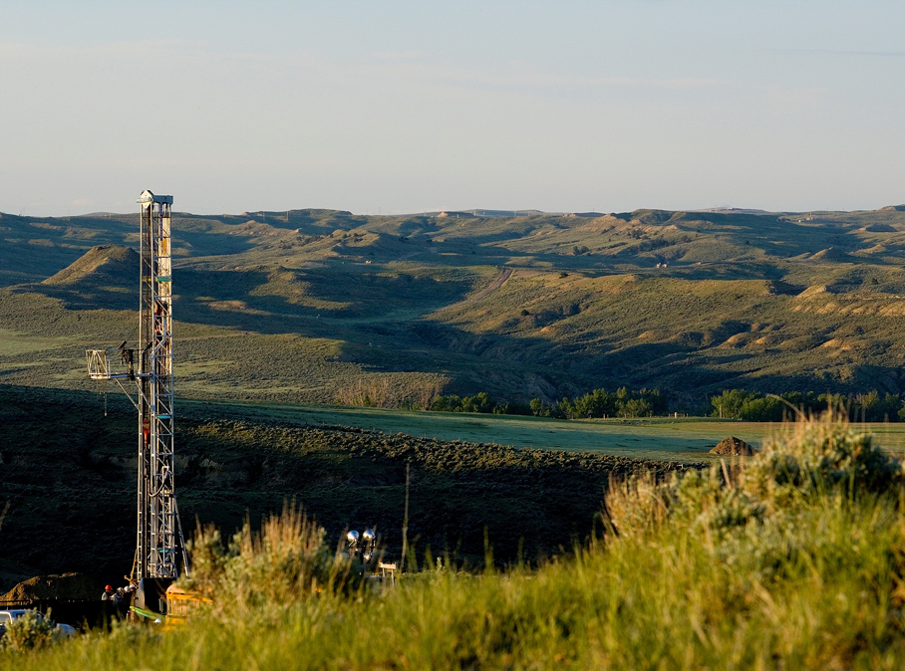
Wyoming Including the Niobrara shale
2011R | 2012R
1,900 | 1,082
Down 43.1% in 2012
1H ‘12 vs. 2H ’12:
Up 24.5%, at 482 wells in 1H
and 600 wells in 2H
Notes:
Across the Rocky Mountain states, activity is primarily in Colorado, Wyoming, New Mexico and Utah. As a group, these states will be up about 5%, to nearly 8,100 wells. However, the forecast varies some from state to state. For instance, Colorado will be up about 8%, and part of that is due to operators taking a look at the Niobrara play, and increasing their level of exploratory drilling. In Wyoming, gas drilling is still the majority of activity, but the ratio is switching toward oil. In New Mexico, the emphasis has switched to the southeastern half of the state, where far more opportunity exists to drill for oil, and away from the gas-prone northwestern half. But this state only expects a 1% gain in activity this year.

Slide 24
Shale Activity, 2012
Wells – Colorado/Wyoming
 | Total rigs | Shale rigs | Total wells | Shale wells
Niobrara
Colorado | 61 | 44 | 2,544 | 1,835
Wyoming | 49 | 1 | 1,082 | 22
Avg. Niobrara frac water usage; 4.0 million gal x 1,857 wells = 7.43 billion gal
Notes:
Given what is happening in Northern Louisiana, it should be no surprise that the state, overall, will be down this year, with a 9% drop to about 1,350 wells. The overall drop is not as severe as that of the northern half, because Southern Louisiana will actually be up 10%. But keep in mind that the volume of wells drilled in the South is only about a third of that in the North. There is more oil drilling in the South, and that trend has been accelerating. Back in 2009, oil completions outnumbered gas completions about two-to-one. Last year, that ratio increased to about four-to-one.

Slide 25
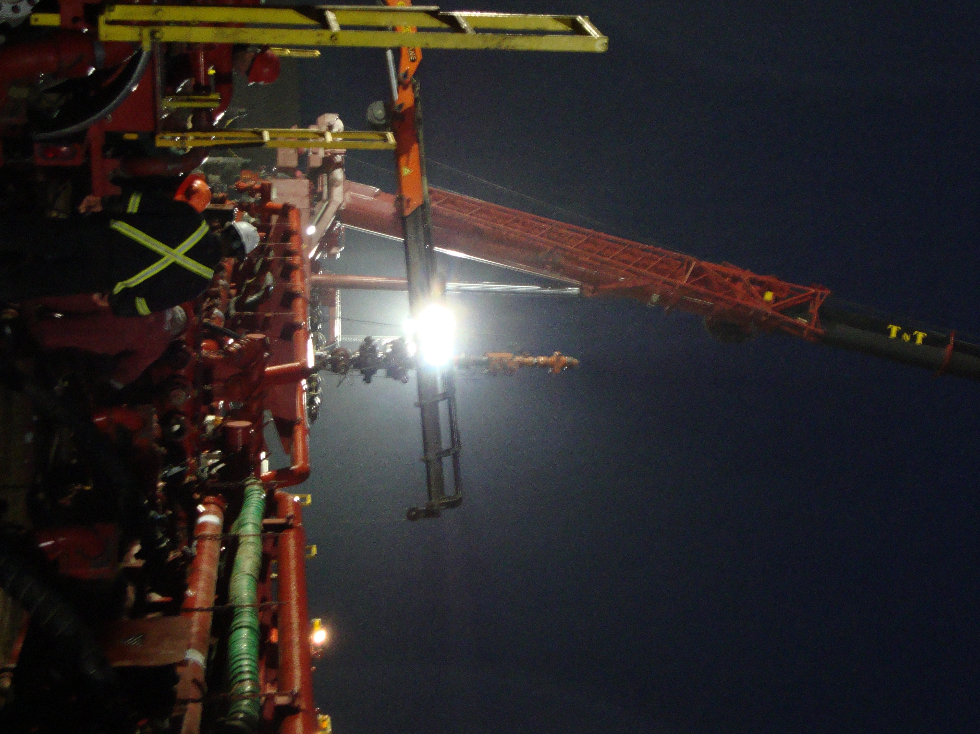
U.S. Shale Activity, 2012
Wells – Major shale plays and water usage
 | Shale wells | Water usage, billion gal
Eagle Ford | 3,292 | 11.50
Niobrara | 1,857 | 7.43
Bakken | 2,442 | 6.84
Barnett | 2,002 | 6.01
Marcellus | 2,160 | 5.40
Haynesville | 671 | 3.36
Fayetteville | 694 | 2.98
Utica Total, major plays | 665 13,783 | 1.66 45.18
Notes:
Given what is happening in Northern Louisiana, it should be no surprise that the state, overall, will be down this year, with a 9% drop to about 1,350 wells. The overall drop is not as severe as that of the northern half, because Southern Louisiana will actually be up 10%. But keep in mind that the volume of wells drilled in the South is only about a third of that in the North. There is more oil drilling in the South, and that trend has been accelerating. Back in 2009, oil completions outnumbered gas completions about two-to-one. Last year, that ratio increased to about four-to-one.

Slide 26
Questions? / Contact
Kurt Abraham Executive Editor
World Oil magazine Gulf Publishing Company
kurt.abraham@worldoil.com
www.worldoil.com
Notes:
2011 was certainly a year of growth and comeback for the oil and gas industry and we believe this trend will continue throughout 2012. We expect solid, moderate growth for the E&P sector, in most regions .

