Slide 1

Analysis of Water Use and Consumption by Texas Power Plants
Gary Gibbs
Government & Environmental Affairs Manager, Texas
American Electric Power

Slide 2

THE ISSUES
CONFUSION
RETRO-FIT
?
REPERCUSSIONS
WATER
USE VS CONSUMPTION
COOLING
Texas Center for Applied Technology
Texas Engineering Experiment Station
Texas A&M University System
ENERGY
Notes:
There is confusion over the interdependence of energy and water and the influence of cooling technologies on that relationship
When this study was being initiated, it was being suggested that Texas power plants be retrofitted with the “latest” cooling technology without understanding the repercussions of such actions
There is a need to quantify water use and water consumption into an everyday context

Slide 3
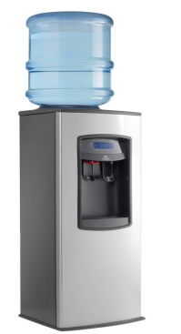

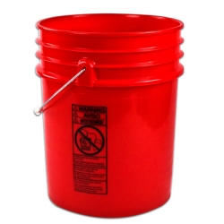


OBJECTIVES OF THE STUDY
CLARIFY
USE
CONSUMPTION
ONCE-THROUGH
WET TOWERS
AIR COOLED CONDENSERS
ECONOMIC IMPACTS OF MANDATING A SINGLE COOLING TECHNOLOGY
CONTEXT
+
=
Notes:
The objectives of this study were to clarify the relationship between energy and water by accurately describing the different cooling technologies in terms of water consumption.
The term use is often substituted for the more specific terms withdrawal or diversion, which can confuse matters. Water use is a general term that can refer to either consumptive or non-consumptive use. Water use includes drinking, flushing toilets, irrigation, evaporative cooling, boating, fishing, and many other applications.
Water consumption refers to a water use that makes it no longer available for other uses. Examples are drinking water, evaporated water, or water incorporated into a product like corn or concrete. When water is consumed, it is no longer available in the system. Consumption is a truer, “big picture” measure of impact on water resources.
While performing an economic impacts analysis was outside the scope of this study, we did acknowledge the fact that there are economic impacts of mandating a single cooling technology whether Retrofitting or with a New build
The final, and possibly most significant objective was to present the results with proper context

Slide 4
METHODS
REVIEW:
ARTICLES
WHITE PAPERS
WEBSITES
REPORTS
SCHOLARLY WORKS
DATABASES
COSTS
ANALYZED MULTIPLE DATASETS TO QUANTIFY WATER USE-CONSUMPTION, & ENERGY USE-CONSUMPTION
Notes:
In order to clarify the relationship between energy and water and to describe the different cooling technologies in terms of water consumption, hundreds of articles, reports, white papers, peer reviewed scholarly works, websites, and online databases were reviewed.
The primary source of data for the costs of retrofits and new construction came from studies conducted by EPRI and Dr. John Maulbetsch.
Data for water use, water consumption, energy production, energy consumption, and demographics came from many sources including
A sample from several power companies that participated in this study
US Department of Energy
US DOE, Energy Information Agency (EIA)
US Geological Survey (USGS)
USGS Circular 1344
The Texas Commission on Environmental Quality (TCEQ)
The Texas Water Development Board
The Office of the Texas Comptroller of Public Accounts
The Texas State Historic Society
Used the most recent data (2010) possible in the study

Slide 5
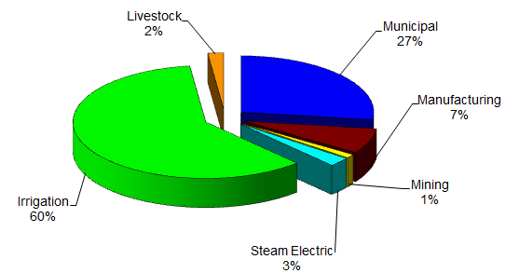
2009 Water Consumption in Texas by Sector

Slide 6
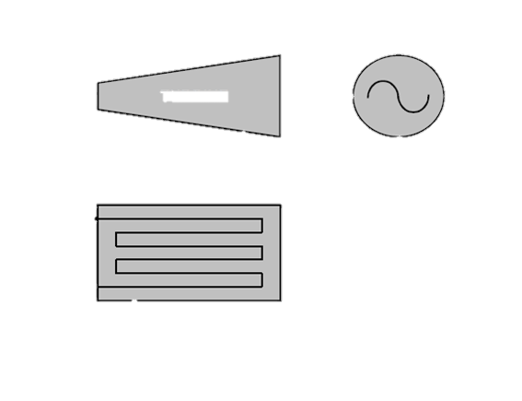

“Once-Through” Reservoir Cooling System
Process Steam
from Boiler
Evaporation, Radiation, & Convection Cool Water
Generator
Turbine
Process
Steam
ELECTRICITY
Cooling Reservoir
Warmed Water
Condenser
Condenser
Recirculated Cooling Water
Cooled Water
Process Water
to Boiler
As Needed
Makeup Water
Notes:
With once-through systems cooling water is pumped through a condenser to condense the steam which is then pumped back to the boiler to complete the cycle. Virtually all the cooling water is returned to the cooling reservoir where it re-circulates, cools naturally, and can be pumped back to the condenser or used for other purposes (e.g. within the power plant, for recreation, or by other industrial users.)
Make up water can come from rain & storm water runoff and/or surface water. It may also use municipal wastewater treatment plant effluent.
It should be noted that the term “once-through” is appropriate where water is withdrawn and returned to a river, but can be misleading for cooling ponds where the same cooling water can be re-circulated through the system repeatedly.
Once-through cooling systems are the simplest, least expensive, and most effective technology for condensing steam, providing the best power plant efficiency (i.e. the most electricity is produced for the amount of fuel burned)

Slide 7
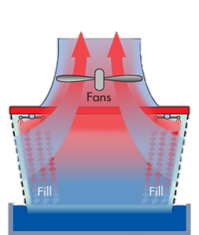
EVAPORATIVE COOLING TOWER SYSTEM
Process Steam
from Boiler
Evaporation Cools Water
Generator
Reuse in other Plant Processes
Turbine
Process
Steam
ELECTRICITY
Warmed Water
Blowdown
Treatment
Recirculated Cooling Water
Condenser
Cooled Water
Discharge
Process Water
to Boiler
As Needed
Makeup Water
Notes:
Thermal power plants using wet cooling tower systems pump water from a water source through a condenser and then to a cooling tower. Large fans (forced draft) or hyperbolic designs (natural draft) provide air flow to dissipate the transferred heat from the cooling water to the air, primarily by means of evaporation. The cooled water is then re-circulated back to the condenser.
Make up water can come from rain & storm water runoff and/or surface water. It may also use municipal wastewater treatment plant effluent.
Wet cooling towers use less, but consume more water than once-through systems.

Slide 8
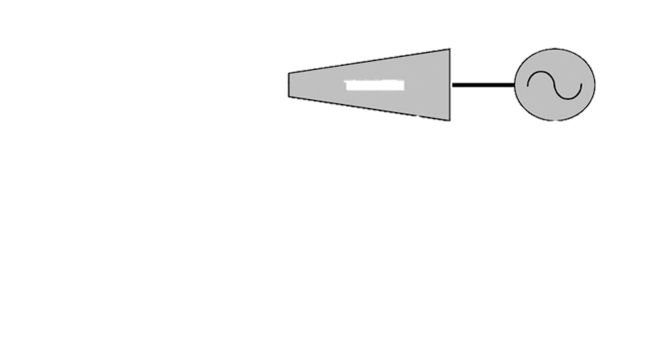


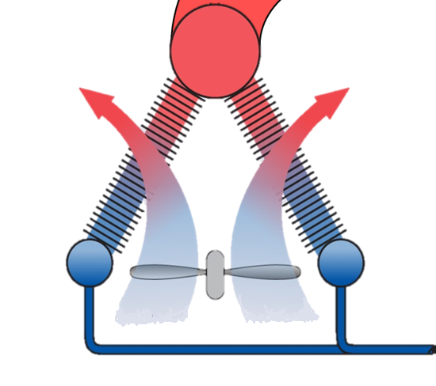
TYPICAL DRY COOLING SYSTEM
Process Steam
from Boiler
Convection
Cools Steam
Generator
Process
Steam
Turbine
ELECTRICITY
Air-Cooled
Condenser
Fans
Process Water
to Boiler
Notes:
With dry cooling, large fans (forced-draft) or hyperbolic towers (natural draft) generate air flow to condense the steam as it flows through finned tubes in the condensers. Cooling water is not needed because the steam is condensed as the heat is transferred directly to the air by means of convection.
The heat transfer to air via convection is less efficient than the previously described heat transfer mechanisms and the heat capacity of air is lower than water, so a significantly larger condenser, greater number and size of fans, and higher air flow are required than for traditional wet cooling towers.

Slide 9
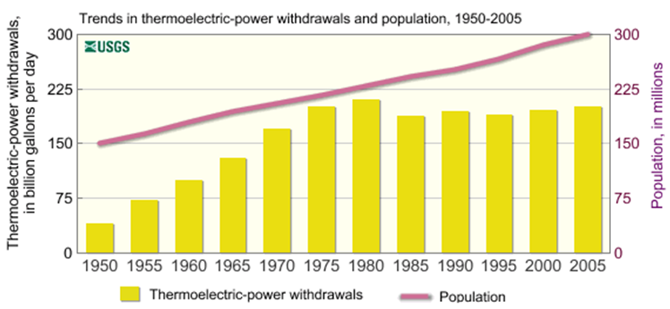
Electric Power Water Withdrawal and Population Trends

Slide 10
Trend for Water Consumption per Unit Energy

Slide 11
Water Use per Household in Texas
Typical American household = 4.6 people, 2,500 sf house, uses 29 kW of electricity each day
Typical Texas once-through plant consumes 9½ gallons of water to produce that 29 kW of power:
  5.7 gallons / day to power a home by NGCC w/OTC
In comparison, the typical American household consumes 300 gallons of water each day. Therefore only 3% of the total water consumed by the typical household is used to generate the electricity.

Slide 12

RESULTS
MANDATING ONE TECHNOLOGY HAS CONSEQUENCES
  RETURN ON INVESTMENT
?
  PREMATURE RETIREMENT
  SUPPLY DEMAND
  RIPPLE EFFECT OF INCREASED COSTS
Notes:
Mandating one cooling technology could have significant consequences
Limits investor’s ability to make a return on investment thereby discouraging future investment
Cause premature retirement of multiple plants
Hinder power producers’ ability to meet the electric demands of the citizens of Texas
Cause a negative ripple effect on both the Texas economy and the national economy
Water conservation is an integral part of current STANDARD OPERATING PROCEDURES for the Texas power industry. As a result :
Texas once-through cooled power plants consume less than 10 gallons of water to produce the amount of
electricity consumed per household per day
Water consumption to energy production efficiency in Texas once-through cooled power plants has improved
over time and continues to do so

Slide 13
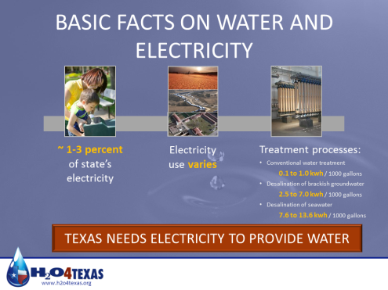

Slide 14
Conclusions
  Water consumption for utility industry typically less than 3% of state’s total consumption, and trend is decreasing
  The electric utility industry has dramatically reduced water consumption over the years, such that any further significant savings will require significant cost to electric customers.
  Only 3% of the electricity used daily in a typical household is required to withdraw, treat and deliver the water used -- and manage the resulting wastewater. Only 3%, what a bargain!!

