Slide 1
Water Issues and the Future of Energy Ed Ireland, Ph. D. President, Ed Ireland & Associates Executive Director, Barnett Shale Energy Education Council

Slide 2
The number one issue: Water
How much water is used to drill and hydraulically fracture a natural gas well? Answer: 3-4 million gallons
What chemicals are added to the water in the fracturing process? Answer: fracfocus.org
Can hydraulic fracturing contaminate fresh water aquifers? Answer: No but good casing and cement are important.
What happens to the water when it come back to the surface? Answer: some is recycled but most is disposed of in deep saltwater disposal wells
For fracture fluid that is disposed of in saltwater disposal wells, isn’t the water forever removed from the hydrologic cycle? Answer: Yes but it is replaced as the hydrocarbons are combusted.

Slide 3
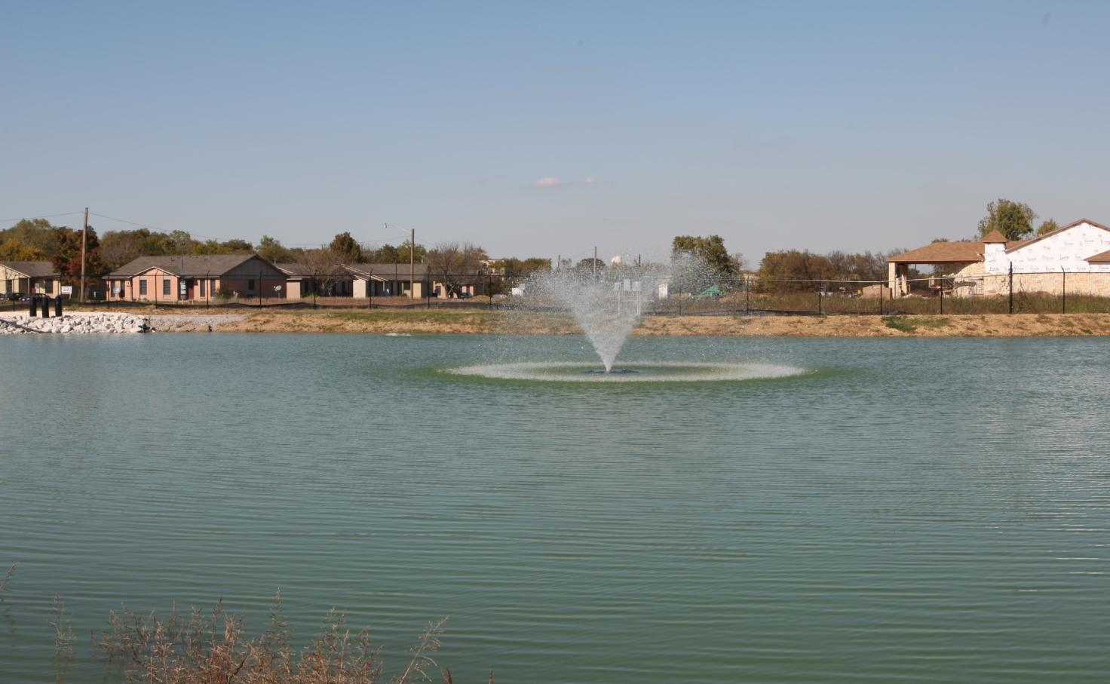
Fresh Water Ponds
Novikoff Frac Pond, Fort Worth

Slide 4
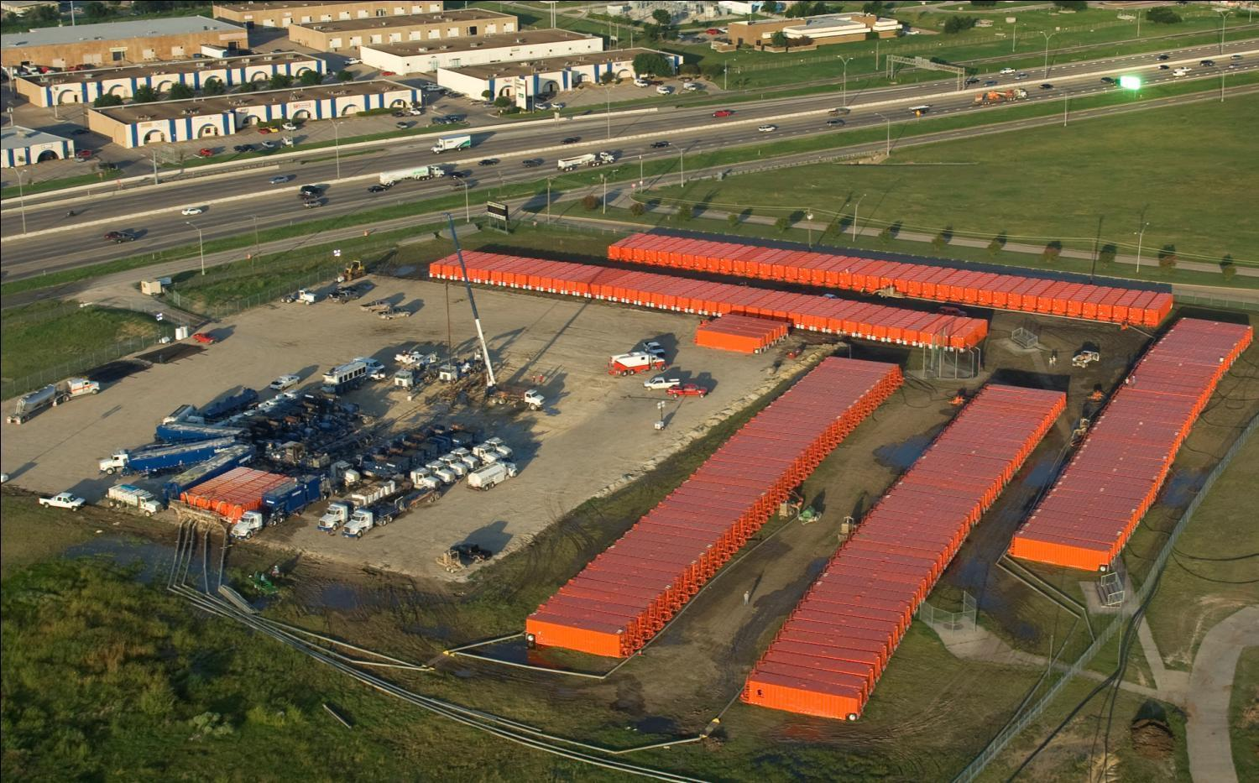
Frac Tanks (when fresh water ponds are not an option)

Slide 7
Natural Gas and the Hydrologic Cycle
In the hydrologic cycle, evaporated water becomes part of nature’s recycling system and eventually returns to the earth as rain
Natural gas, like all fossil fuels, produces water when it is combusted
For every 1 million cubic feet of natural gas¹ that is burned, about 10,675 gallons of water are produced²
A typical Barnett natural gas well, producing 2 million cubic feet per day, creates more than 20,000 gallons of water daily³
It takes just 250 days of production and combustion to replace the water used to drill and frack a Barnett well
Water produced from natural gas development and combustion is water that would not have been in the atmosphere otherwise
Each Barnett well, which is expected to produce 30+ years, contributes far more water to the hydrologic cycle than it uses
Notes:
1 Assuming standard 95% methane, as is found in the Barnett Shale
2 Chesapeake Energy Corporation, September 2010
3 Assuming all of the natural gas is combusted

Slide 8
Natural gas is the lowest carbon fuel we have (other than nuclear)
Substituting natural gas for coal has already reduced carbon dioxide emissions in the U.S. back to 1990 levels, which is what the Kyoto Protocol sought to accomplish.
Natural gas as a transportation fuel is much cleaner than gasoline or diesel.

Slide 9
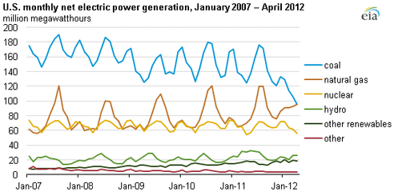
Nat Gas Catches Coal!!

Slide 10
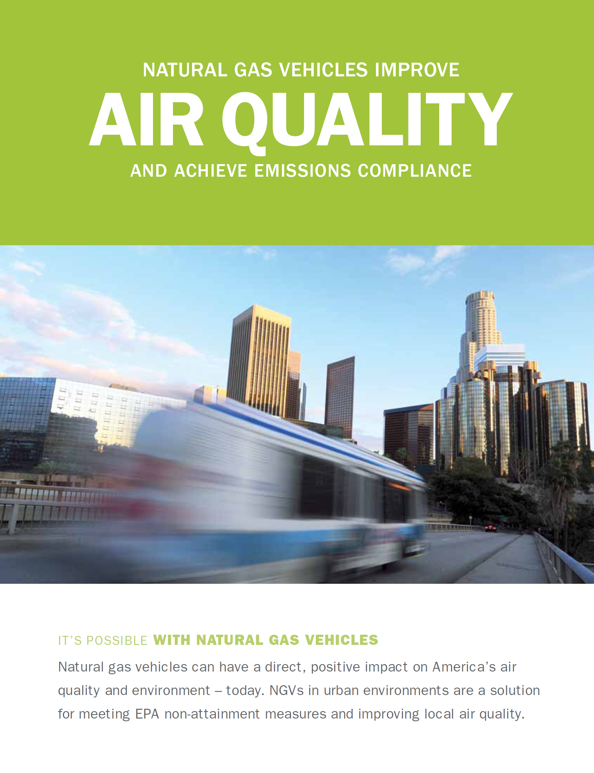
NGVs: The Real “Green Vehicles”
Natural Gas vehicles…
Reduce CO₂ emissions
20-30%
Reduce CO emissions
70-90%
Reduce NOx emissions
75-95%
Reduce Particulate Matter emissions
90%
Reduce VOC emissions
89%
…compared to gasoline or diesel

Slide 11
And BSEEC co-founded the
Metroplex Natural Gas Vehicle Consortium

