Slide 1
Energetic-based Well Stimulation
Alliant Techsystems Operations LLC (ATK)
October 2012
THE ATK LOGO IS A REGISTERED TRADEMARK OF ALLIANT TECHSYSTEMS.
ALLIANT TECHSYSTEMS OPERATIONS LLC
PROPULSION AND CONTROLS 55 THIOKOL ROAD, ELKTON, MD 21921 (410) 392-1000

Slide 2
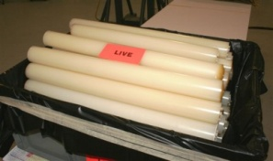
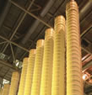
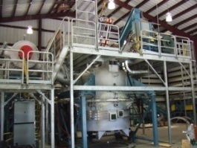
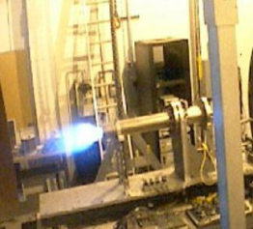
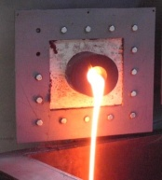
ATK Business Overview
A Fortune 500 company with ~ $4.6 billion in revenue
World’s top producer of solid rocket propulsion systems; provider of advanced composite structures and components; supplier of satellite components and subsystems
World’s largest producer of military ammo; leader in affordable precision weapons, propellants, & energetics
Leader in missile propulsion, warheads, fuzing, missile warning systems, and missionized aircraft
Leading brands in law enforcement & sporting ammunition; leader in hunting & shooting accessories
Located in 24 states & Puerto Rico with representatives in 50+ countries worldwide
Focused on delivering affordable and innovative solutions
Energy-Related Products &Technology
Oil and Natural Gas Products
Nuclear Power Products
Elkton, MD
Ronkonkoma, NY
Down-Hole Propellants
Propellant Sticks
Propellant Sleeves
Propellant Pucks
Advanced Ignition Application
Initiators/Detonators
Next-Generation
Down-Hole Devices
Steam Generators
Addressable Devices
Pipe Cutters
Composite Tools
Renewable / Alternative Energy Products
Rocket Center, WV
Elkton, MD
American
Centrifuge Program
Manufacturing Composite Rotor
Service Commercial Uranium Enrichment
Rocket Center, WV
Ronkonkoma, NY
Elkton, MD
Thermochemical Conversion
Waste to Energy
Gasification
Hydrogen Storage
Vehicles, Integration
Testing
Fuel Reforming
HySpike
Auto Thermal Reformer
JP-8 to Hydrogen
Metal Manufacturing
Welding
Turning and Milling
High volume mfg and assy.

Slide 3
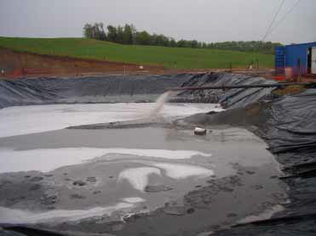
Current Hydraulic Fracturing Process
Water usage exceeds 3-5 million gallons per well + disposal

Slide 4
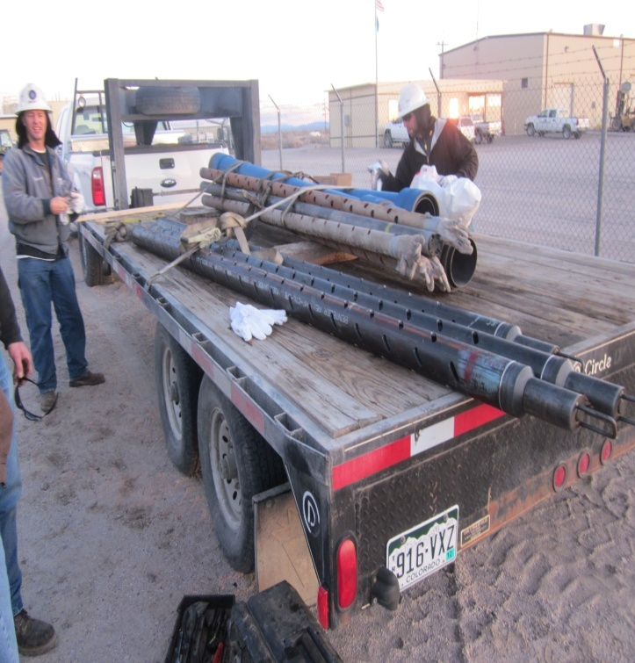
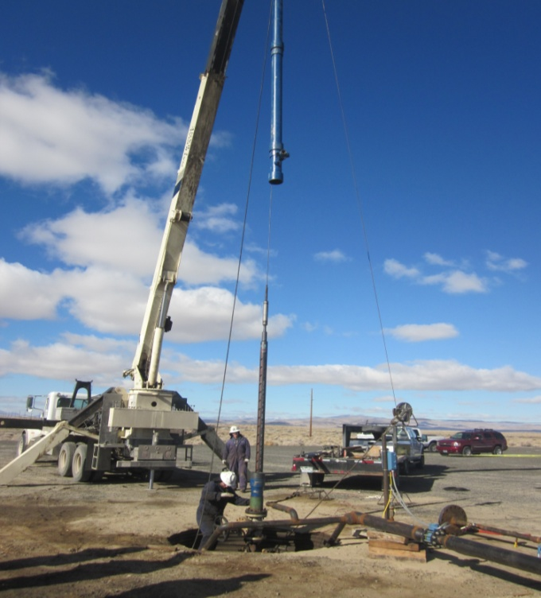
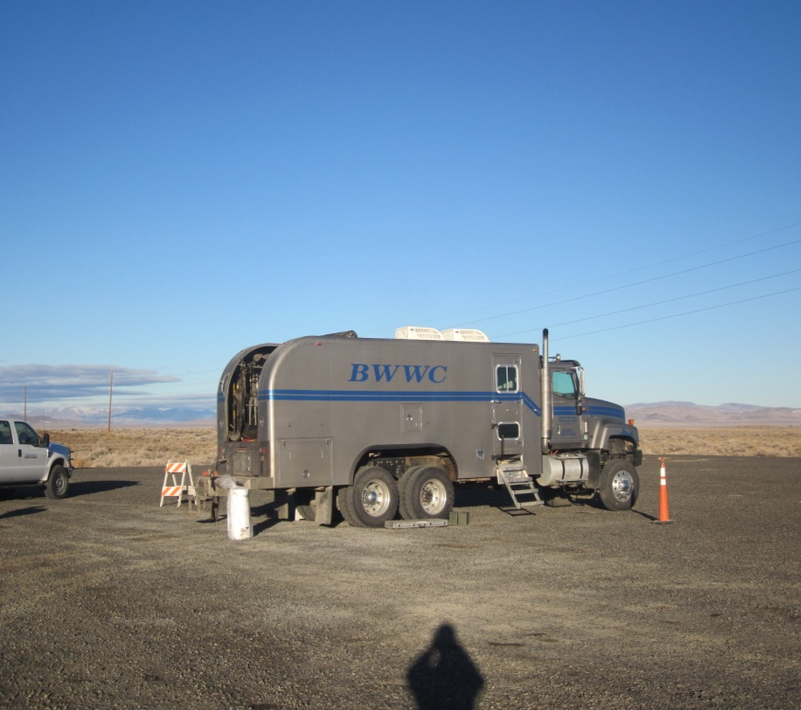
ATK’s Fracking Procedure
ATK’s energetic-based procedure requires:
No change in current well drilling, casing, perforation
No specialized or modified tools
Minimal equipment
Short set-up time

Slide 5
Down-hole Fracturing Application
ATK, partnered with PPS, has developed an energetic-based alternative/augmentation to the current hydraulic fracturing process
Solid propellant is ignited generating specified volume of gas creating pressure that fractures the rock
Propellant type, amount, & burn rate can be adjusted depending on geological conditions
Propellants can be designed to operate in the pressure and rise rate regime between single-blast explosives and HF
Extension of fractures can be controlled
Distance from wellbore: 10 to 100 feet
Directional: 360° to 45°
Propellant solution is adaptive and can be readily modified, fabricated, and demonstrated with new formulations based on fracturing requirements
Applicable for use in oil, gas & geothermal wells
Re-stimulation of existing wells
In concert with hydro fracking (e.g. reduce breakdown pressures)
Substitution for hydro operations

Slide 6
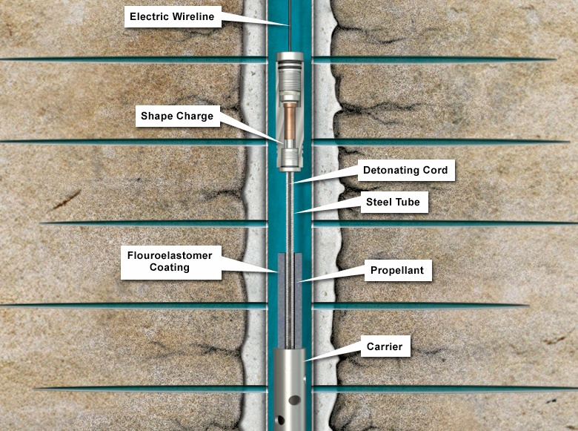
Solid Propellant Stimulation Tool Description
Environmentally sealed ignition designed tool with pre-machined fracturing segments that ideally provide equal flame spreading and, therefore, completely burn the propellant grain
Configuration design is critical to the success of the tool
Assembled at well site to assure maximum tool benefit and ease of transfer
Results can be measured in the same day
Successfully tested in several application and down-hole conditions

Slide 7
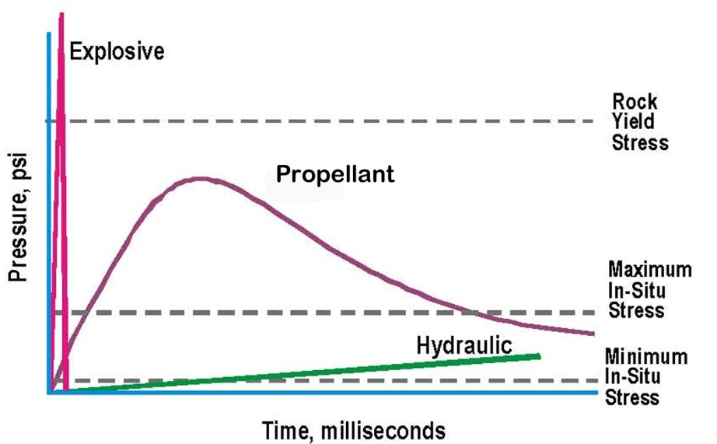
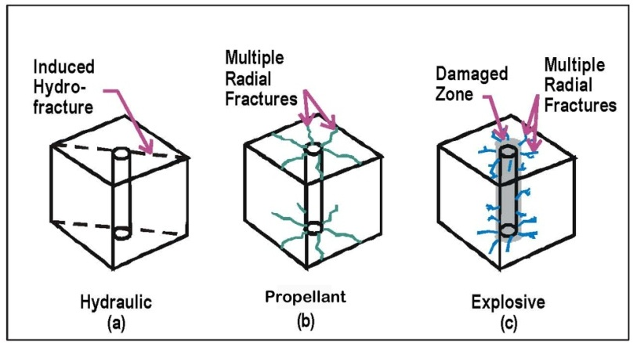
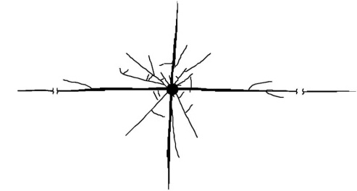
Benefits of Energetics Fracturing Process
PRIMARY BENEFITS
Release of the gas disbursement
Explosives 1,000,000 psi in 1 microsecond
Hydraulic 5,000 psi in 1 hour
Propellants 20,000 psi in 10 milliseconds (Tailored)
Reduces or eliminates the amount of water required
Drastically reduces or eliminates the disposal of used
fracturing water
Much lower cost
50% cost reduction versus current procedure
Minimal on-site equipment
Shorter service time needed to get well on line
ADDITIONAL BENEFITS
Eliminates the need for chemicals to alter the success of the fracturing technique
Creates multiple fractures with controls instantly around boreholes to eliminate aquifer contamination
Increases injection & withdraw rates in gas storage wells
Removes “skin” and cleans the wellbore damage the perforating process creates, which reduces breakdown pressure in some formations
Improves effectiveness of acidizing by using propellant before acidizing
Stimulates selected zones without the need to set packers
Minimal formation damage from incompatible fluids and minimal vertical growth out of the pay zone
Bottom line: Increased performance, lower cost

Slide 8
Energetics-based Stimulation Technology
Features
Propellant is highly energetic & long burning for an extended propellant treatment
Unique initiation process and patented coating process ensures predictability
Variable surface area ignition increases or decreases the release of gas as needed
Wireline, tubing (TCP) and coiled tubing conveyed
Specifications
Maximum temperature: 450°F 1 hour
Hydrostatic pressure up to 14,500 psi
Standard propellant cartridges come in three sizes
Multiple diameters (1.2 to 3.4 inches in diameter)
Propellant logs are casted in logs up to 36 inches in length
Custom tailoring of sizes can be manufactured if needed

Slide 9
Corollary Benefits
Beyond time & production advantages, ATK’s energetic-based extraction technology has the following attributes:
Eases competing community demands for (often scarce) water resources
Reduces traffic congestion/usage and the need for associated road repairs
Smaller operating footprint is more acceptable to environmentally conscious communities
ATK’s record of handling, transporting, and operating safety provides additional assurance to hosting communities
Reduction/elimination of chemicals viewed more favorably by communities with concerns regarding impact to their land

Slide 10
Case Studies
ATK has conducted demonstrations on more than 500 wells using solid propellant technology with results from ~50 down-hole treatments
Demonstrations performed in 11 states in multiple well designs garnered positive results
225% increase in production propellant vs. hydraulic stimulated wells
200% increase in volume with 75% decrease in the pressure for disposal wells
100% increased in old re-stimulated well production
30% to 50% reduction in pressure required to breakdown wells
Demonstrated utility for repair operations (e.g., stuck components)
Demonstrations proved successful in test wells in Alabama, Alaska, Arkansas, California, Colorado, Louisiana, Kentucky, Mississippi, Oklahoma, Texas, Utah, Gulf of Mexico, and Ireland

Slide 11
Going Forward
ATK is actively pursuing the following:
Additional test wells to validate and quantify initial positive results
Collaborative teaming with industry leaders to develop additional propellant formulas that are customized to optimize specific geological plays
Extension of geological penetration beyond current reach
Entry into vast international market

Slide 12
Backup Slides

Slide 13
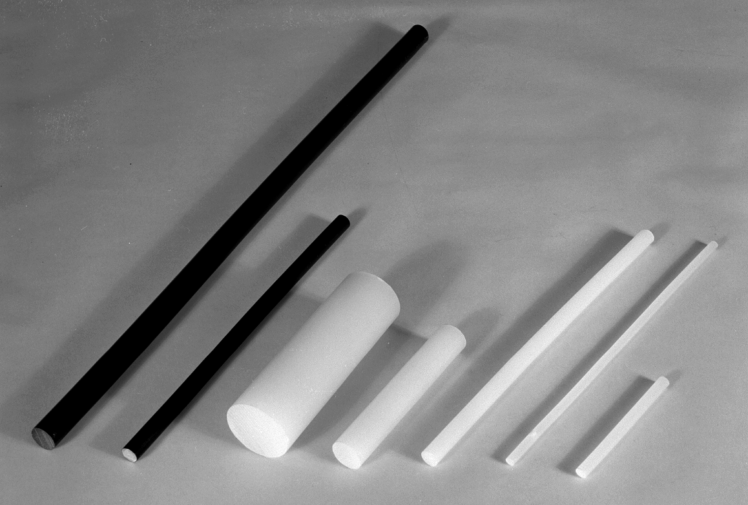
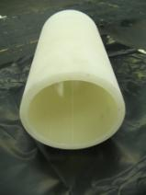
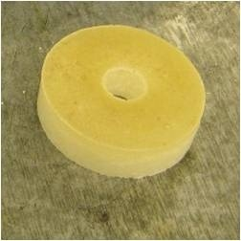
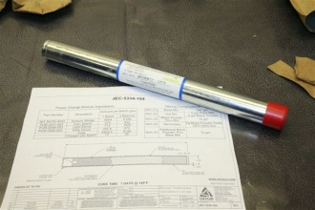
Down-Hole Propellant Products
1) ATK heritage oil tool products
3) Advance ignition devises
2) Various product configurations
Applications
Advantages
Customers
Gas generation for chemical cutter tools and well stimulation to include:
Zonal isolation
Horizontal wells
Pre-fracturing treatment
Augmentation to existing tools (perforation guns, fracturing sleeves)
Viable alterative to STIM
consortium
HT/HP
Power charge devices
Tailorable pressure output
Unlimited product configuration
Favorable (4.1) DOT classification
Standard export classification
Significant capacity and availability of product
Short lead time
Extensive down-hole pedigree
Pipe Recovery Systems (PRS)
Chemical Cutter Incorporated (CCI)
Diamondback Industries
Precise Propellant Stimulation (PPS)
Owen Oil Tools
DYNAenergetics

Slide 14
Propellant Chemical Composition
All solid propellant is consumed producing the following gaseous constituents:
Chemical Name | Chemical Symbol | Amount Present (%)
Hydrochloric Acid | HCL | 30.54
Carbon Monoxide | CO | 24.70
Water | H2O | 22.17
Carbon Dioxide | CO2 | 12.31
Nitrogen | N2 | 8.93
Hydrogen | H2 | 1.33
Chlorine | CL | 0.03
Ammonia | NH3 | 0.01
 | Total | 99.98

