Slide 1

Short Commercial about NARO
What does this statement mean?
Who are we?

Slide 2
NARO was founded in 1980
Due to Windfall Profits Tax
We have grown into an educational/advocacy organization
NARO has two “parts”
The Association a 501 c (6)
The NARO-Foundation a 501 c (3)

Slide 3
NARO State Chapters
Arkansas-NARO
NARO-Appalachia KY, OH, WV
NARO-New York
NARO-Pennsylvania
NARO-Louisiana
NARO-Rockies CO, MT, ND, NM, UT, WY
OK-NARO
NARO-Texas

Slide 4
Water use clause in O & G Lease
Lessee shall have free use of oil, gas and water from said land, except water from Lessor's wells, tanks, creeks, rivers, streams and springs, for all operations hereunder, provided that no surface water or underground fresh water will be used for water flood or pressure maintenance purposes

Slide 5
New Water Use Clause
Lessee shall not have any right to use water from Lessor's springs, ponds, wells, creeks, streams or facilities for any operations hereunder without Lessor's written consent. Any water well drilled by Lessee upon the leased premises with Lessor’s written consent shall be left intact and become the property of Lessor upon the termination of this Lease as to that portion of the leased premises upon which such water well is located. Lessee may not use any fresh water from the leased premises for any waterflood, pressure maintenance or other secondary recovery operations. (ii) Lessee shall maintain the quality and quantity of Lessor’s domestic water supply by testing the supply prior to and at the completion of operations and as deemed necessary by Lessor due to changes in flow or quality, including but not limited to, color, smell or taste. Should the water supply be polluted or reduced, Lessee shall take any and all steps to restore water quality and quantity to its pre-existing condition. During the period of remediation, Lessee shall supply Lessor with an adequate supply of potable water consistent with Lessor’s use of the damaged water supply prior to Lessee’s operation. Any pollution or reduction of any water supply will be presumed to be the result of Lessee’s operation unless Lessee can affirmatively otherwise prove.

Slide 6
Other Operational Concerns
Pits. Lessee shall have no right to dig any pits on the leased premises except with Lessor's written consent; provided, however, that Lessee may dig and use pits for drilling operations if (a) such pits conform to DEP requirements, (b) the pit is planned to be deep enough to allow at least thirty-six (36) inches of backfill over the liner after grading to the surrounding pre-drill contours, and (c) promptly after completion of operations paragraph 6(b) pits are drained, prepared for burial, backfilled, graded and planted within ninety (90) days (weather permitting), in accordance with paragraph 20(a) (v). Lessee shall immediately notify Lessor and the DEP if any pit lining is torn, punctured, or otherwise breached, allowing any fluid contained in a pit or designated to be contained in a pit to seep, leak or overflow through or around the liner.

Slide 7
Class II injection wells
Today there are approximately 170,000 Class II injection wells located in 31 states.
All Class II injection wells are regulated by either a state agency which has been granted regulatory authority over the program, or by USEPA.

Slide 8
Class II wells are categorized into three subclasses
Salt Water Disposal Wells
Enhanced Oil Recovery Wells
Hydrocarbon Storage Wells

Slide 9
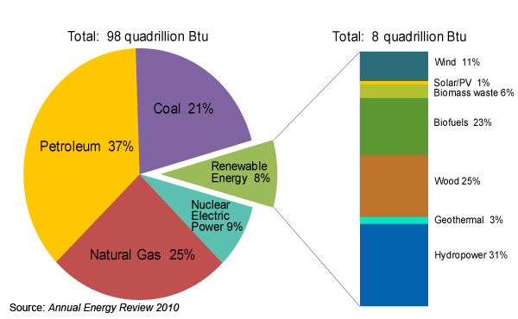
Fossil fuels provide 83% of U.S Energy
U.S. Energy Information Administration

